Slide 1
THE GILDED AGE 1870S-1890S

Slide 2
WHY CALL IT THE “GILDED AGE”?
gild·ed ˈɡildəd/
adjective
covered thinly with gold leaf or gold paint
wealthy and privileged

Slide 3
Wait… but I thought people were poor FACTORY WORKERS
But the rich were *super* rich. Like. Super. Rich.

Slide 4
Captain of industry? Or robber baron?
Robber baron: a person who has become rich through ruthless and unscrupulous (not honest or fair) business practices

Slide 5
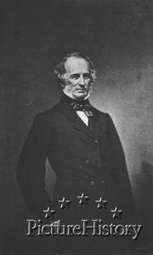
CORNELIUS VANDERBILT (1794-1877)
Controlled much of the shipping business in New York
Connected New York to Chicago by rail
Founded Vanderbilt University in Tennessee

Slide 6
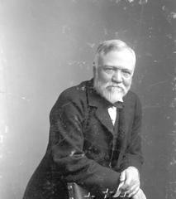
ANDREW CARNEGIE (1835-1919)
Carnegie Steel Company (later became US Steel)
Monopoly – controlled vertical and horizontal integration
Inequality is inevitable and good
Rich should take care of the poor
“The Gospel of Wealth”
Donated 90% of his wealth

Slide 7
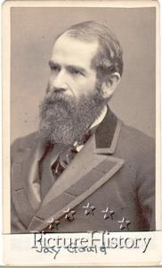
JAY GOULD (1836-1892)
Bought large blocks of railroad stock, building the transcontinental railroad
Purchased Western Union Telegraph after falsely reporting information about their credit in his newspaper, New York World
Fortune estimated around $80 million, left most to family and trustees

Slide 8
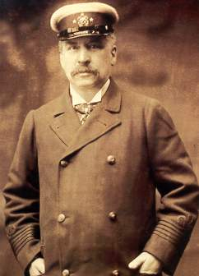
JP MORGAN (1837-1913)
Created US Steel – the world’s first billion-dollar corporation – in 1901.
Big banker and financer
In 1913, his estate was worth $80 million ($1.2 billion today)

Slide 9
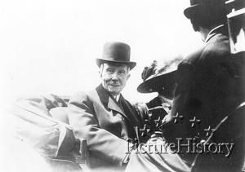
JOHN D. ROCKEFELLER (1839-1937)
Owned Standard Oil Company
Controlled the oil industry through trusts
Drove out competitors through selling his oil at a lower price
Wealthiest human of the modern period – worth $336 billion
Gave away about half of his wealth

Slide 10
HEROES OR VILLAINS?
Individually or with ONE partner, research one of the industrialists, and decide whether or not he is a robber baron or a captain of industry.
After your research, answer the question: is he more good or more bad?
This is subjective! What is “good” to you? Did he use his wealth well? Do his philanthropic efforts outweigh his corrupt practices?
Create a “wanted” or “praise” poster for your industrialist!
Wanted: for being corrupt and terrible
Praise: for being a wonderful human who gave back to society
Get in your groups now.

Slide 11
Tomorrow: we will present
And rank them! Who is the best? Who is the worst?

