Slide 1
AGENDA
Today: Native Americans in the West
Hw: reading and notes ☺ quiz on FRIDAY

Slide 2
The story of the west: Native americans

Slide 3
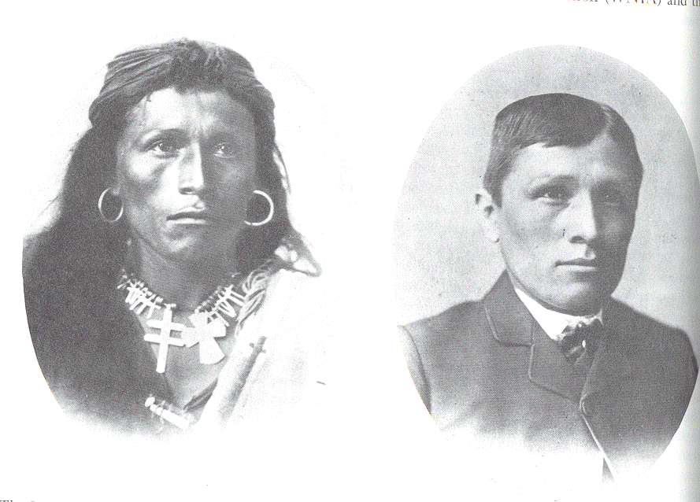
WARM UP
What do these two images show you about how Native Americans were treated in the West?
The photographs above depict the same individual: the photo on the left was from his earlier life; the photo on the right was a couple of years later. Describe the differences you see between the two photos. Be specific.

Slide 4
More art analysis!
Remember:
1) what do you see in the painting
What symbols are present? What do they represent?
2) what is the artist’s message?
What is the artist trying to tell you through this painting?

Slide 5
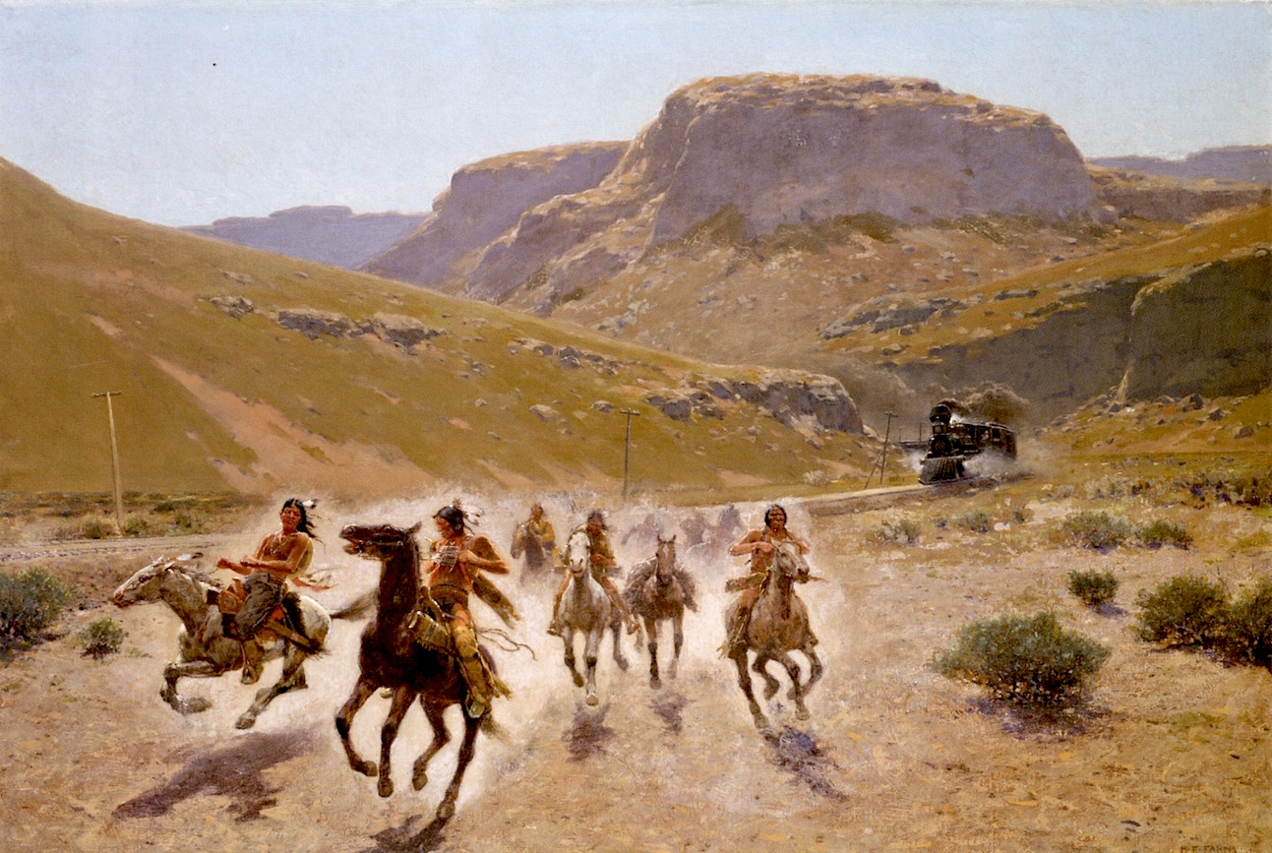
“Coming of the Firehorse” – Henry Fany

Slide 6
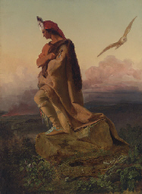
“Last of the Mohicans” – Charles Russell

Slide 7
Sand CREEK MASSACRE
What really happened?

Slide 8
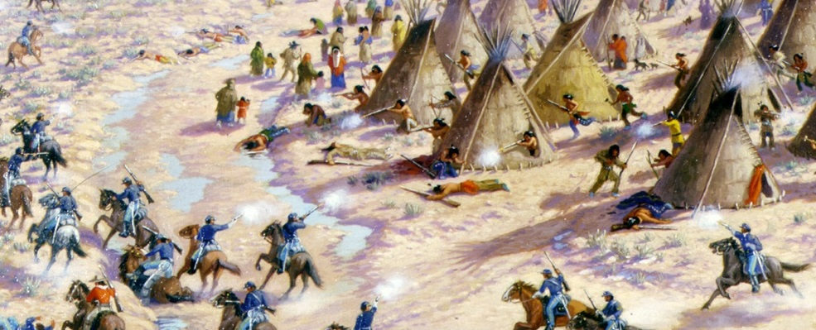
Embrace your narrative. Read through your account and take it to heart.
Each person will share their viewpoint. Take notes as others share.
At the end, try to figure out which viewpoint is most reliable. Consider biases of each person!

Slide 9
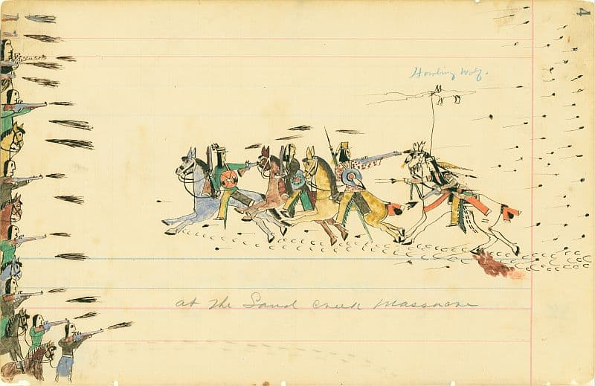
Howling Wolf recounts the Sand Creek Massacre…

