Slide 1
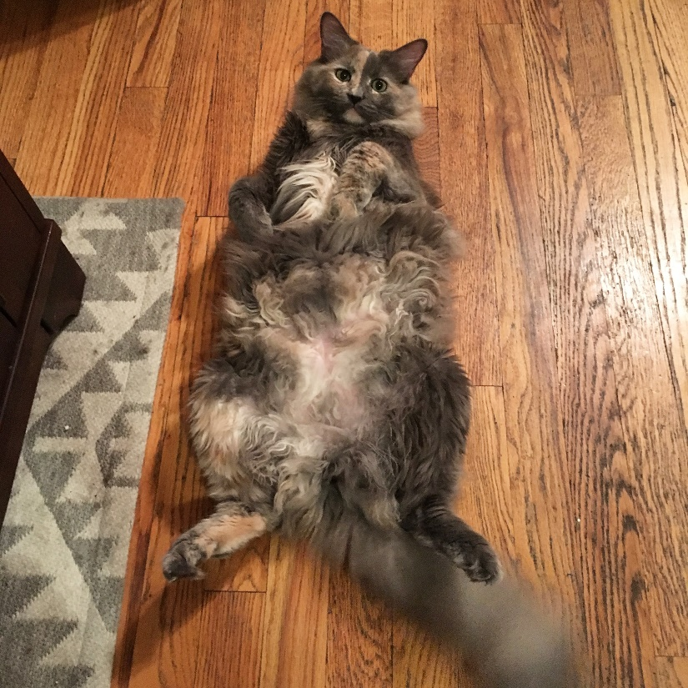
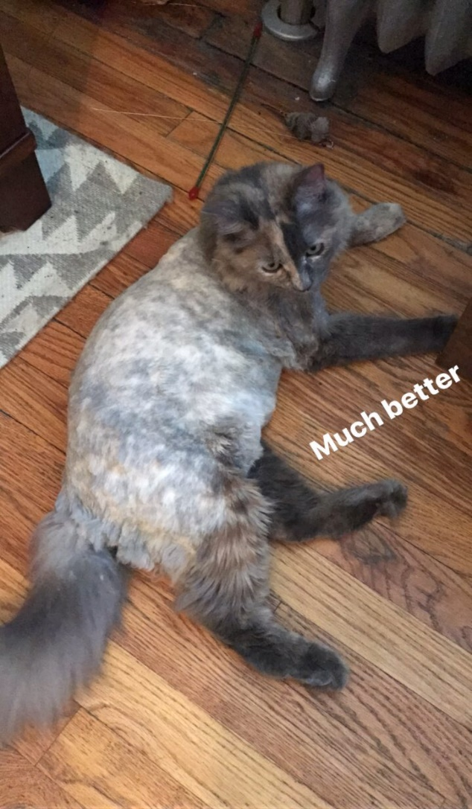
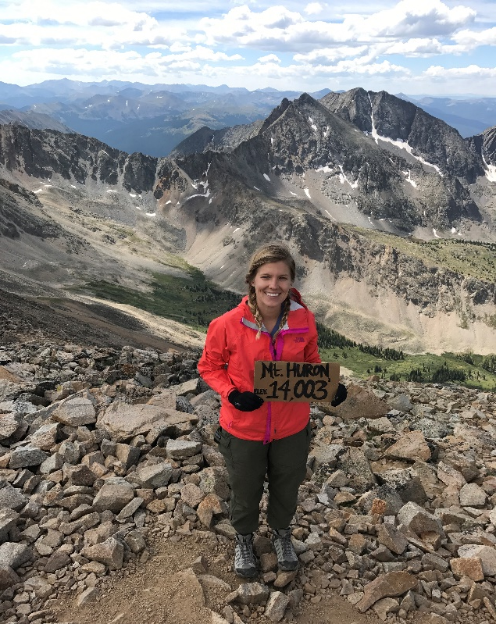
AGENDA
Warm up: HIPP practice
Lesson: causes of the Civil War
Homework: none
Things I did this weekend:
Shaved my cat
Climbed Mt. Huron

Slide 2
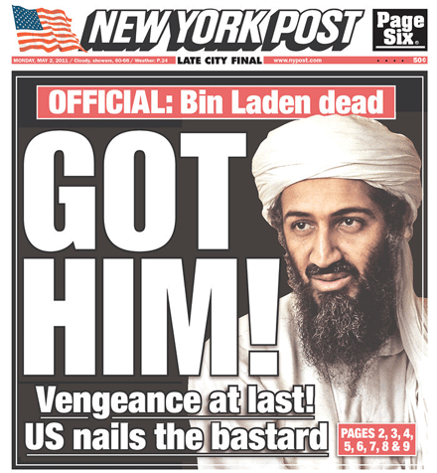
May 2, 2011

Slide 3
“America’s promises do not come with a price tag. We meet our commitments. And that’s one reason why almost every country on Earth sees America as stronger and more respected today than they did eight years ago.
America is already great. America is already strong. And I promise you, our strength, our greatness, does not depend on any one person.”
- President Obama, speech at the Democratic National Convention, July 27, 2016

Slide 4
THE CIVIL WAR
Learning target: Identify major causes of the Civil War

Slide 5
VOCABULARY
In your notebook, create a table that has three columns. Define the following terms in your own words, and draw a picture to represent the term.
Civil War
Abolition
Sectionalism
Agrarian
Industrial
Secede/secession

Slide 6
CAUSES OF THE CIVIL WAR
Brainstorm:
What were the causes of the Civil War?
What advantages did the North have?
What advantages did the South have?
Notes:
Causes- secession, conflict between north and south, slavery, state’s rights
North: more food, industry, people, railroads, Lincoln
South: military generals, incredible motivation

Slide 7
CAUSES OF THE CIVIL WAR: SECTIONALISM
or, Differences between North and South
Growing cultural and economic differences
Interests of each section was more important than interests of the country as a whole

Slide 8
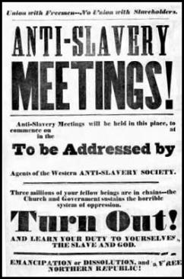
CAUSES OF THE CIVIL WAR: ABOLITION
or, the desire to end slavery
Social reform movement to abolish slavery
Sets Northerners against Southerners

Slide 9
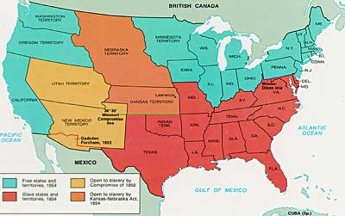
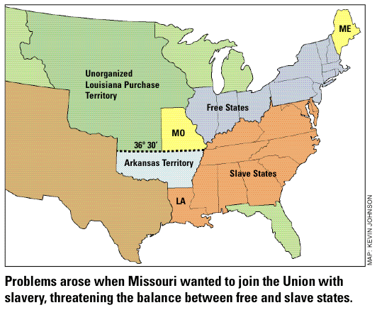
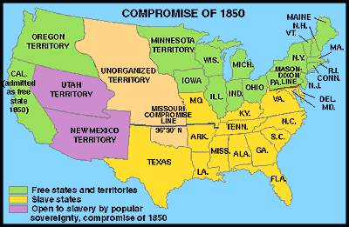
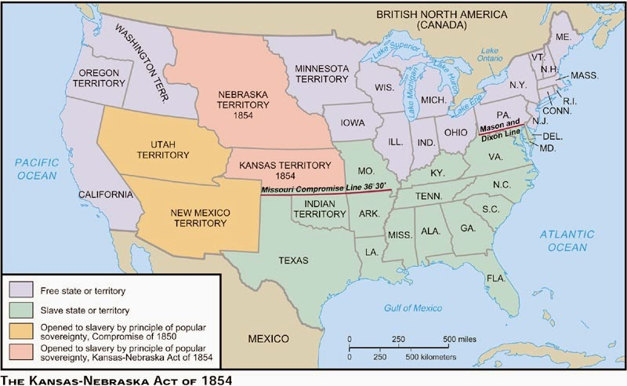
CAUSES OF THE CIVIL WAR: SLAVERY
because forced labor is bad
Division over whether to have slavery in new territories or not
Missouri Compromise
Compromise of 1850
Kansas-Nebraska Act
Missouri admitted as a slave state
Maine as a free state
Slavery was prohibited in land from the Louisiana Purchase north of 36’30, except for Missouri
What to do with the land gained from the Mexican-American War??
Texas lost territory
California admitted as a free state
Utah and New Mexico could decide through voting whether or not they wanted slavery
Slave trade banned in DC
Stricter Fugitive Slave Law enacted
Repealed Missouri Compromise;
Allowed Kansas and Nebraska to vote on slavery
Contributed the most to the onset of war – why?
Notes:
Proslavers and antislavers flooded to Kansas to duke it out – there was a ton of fighting. Called “bleeding Kansas.” Both Kansas and Nebraska ended up entering the union as free states

Slide 10
CAUSES OF THE CIVIL WAR: STATES’ RIGHTS
or, hey Washington, don’t tell me what to do!
Supported by Southerners – fear federal government will take away slaves
North recognized the authority of the national government

Slide 11
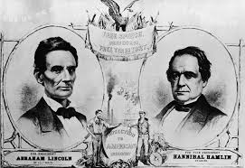
CAUSES OF THE CIVIL WAR: ELECTION OF 1860
Republican Party nominates Abraham Lincoln
Opposed expansion of slavery into territories
Democrat Party supported rights of Southerners to take slaves into territories
Southerners feared they would lose power in government

Slide 12
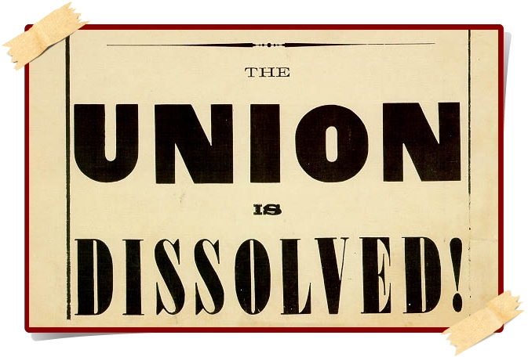
CAUSES OF THE CIVIL WAR: SECESSION
or, the break up
11 Southern states seceded from the Union
Claim they are protecting states’ rights

Slide 13
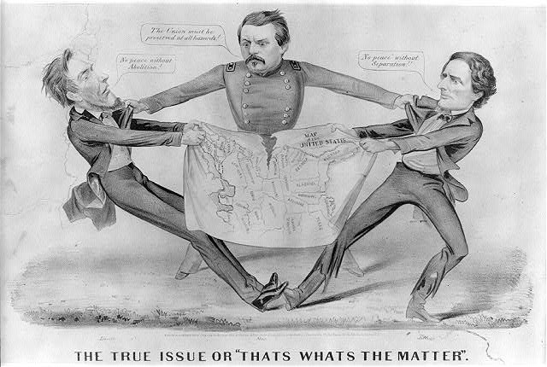
CAUSES OF THE CIVIL WAR: INTERPRETING POLITICAL CARTOONS
Political cartoons often used hyperbole and symbolism to satirize (make fun of) society. They often convey commentary on politics, social issues, and current events.
Notes:
And then present!

Slide 14
CAUSES OF THE CIVIL WAR
HIPP your political cartoon/image
Historical context
What’s going on in the world?
Intended Audience
To whom is the document targeted, and how might that affect what is being said and how it’s being said?
Purpose
What’s the point? Summarize it.
Point of view/perspective
Does the author have any biases? What are they? How might that affect what is being said and how it’s being said?
Other guiding questions:
- What people or objects are shown?
- What, if any, words do you see?
- Why were those words chosen?
What symbols are present?
What do they represent?
- What is the picture about?
Notes:
And then present!

Slide 15
CAUSES OF THE CIVIL WAR
As a group, decide which of the six causes your image matches:
Difference between North and South
Abolition Slavery
States’ rights Election of 1860
Secession
And, be ready to justify why your group chose that!

Slide 16
HOMEWORK
Choose one of the six causes of the Civil War and create either a political cartoon or a regular cartoon addressing the topic.

Slide 17
AGENDA – 8/23
Take out your political cartoon/image and put it on your desk
Does anyone want to share theirs?
Plz plz plz plz plz make sure your name is on it somewhere
Warm up
Fun video!!!!!!!!!!!!
Lesson: analyzing primary sources – soldiers’ letters
How brutal was life during wartime?
Homework: ch 11 study guide due FRIDAY.

Slide 18
WARM UP
In your notes, answer the following question:
Which of those six causes (states’ rights, secession, slavery, abolition, the election of 1860, differences between the north and south) do you think MOST DIRECTLY led to the war? Why? Use evidence to support your argument.
**sentence stems are great!
“____________________ most directly led to the beginning of the Civil War because ___________...”

Slide 19
THE CIVIL WAR
Learning target: Analyzing primary sources to determine point of view

Slide 20
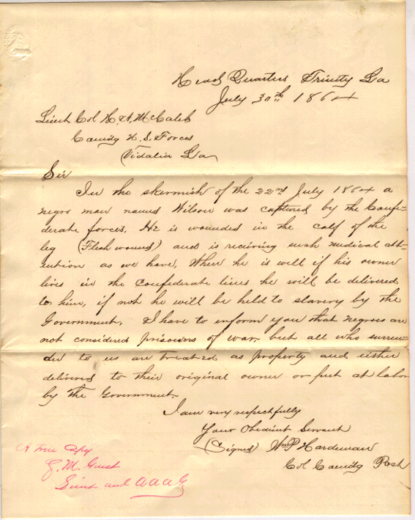
Soldier’s letters
What information can you gather about the war based on primary source documents?
Notes:
Groups of three. Read through the letter together (one at a time) –Venn diagram – similarities, differences between all three

Slide 21
Soldier’s letters
Summarize the letter as a group. Discuss the following:
How does the solider feel about the War?
How did the solider die (if said)?
What else do you find interesting about the letter? Does anything stand out to you?
Did the soldier experience hardship or not? Choose a quote to write down on your sheet.
When you’re done with 1-5, come talk to me and I’ll explain what to do with 6 and 7
Notes:
Groups of three. Read through the letter together (one at a time) – white union soldier, white confederate soldier, black union soldier.
Venn diagram – similarities, differences between all three

Slide 22
AGENDA
Warm up
Effects of the Civil War – what now?
HOMEWORK: CH 11 STUDY GUIDE DUE FRIDAY

Slide 23
THE CIVIL WAR
Learning target: Identify major effects of the Civil War

Slide 24
WARM UP: QUICK DISCUSSION
What side faced the most hardship during the war?
Who won the Civil War?
Just to make sure we all know ☺

Slide 25
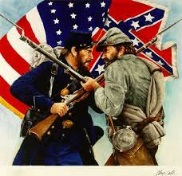
Notes:
So, what does that mean for the south?

Slide 26
WARM UP #2:
Brainstorm the social, political, and economic effects of the Civil War
Having trouble? Think of those effects in relation to any war to get the ideas flowing. 750,000 people died. Slaves are free. What now?
Predict: What do you think will happen in the States?

Slide 27
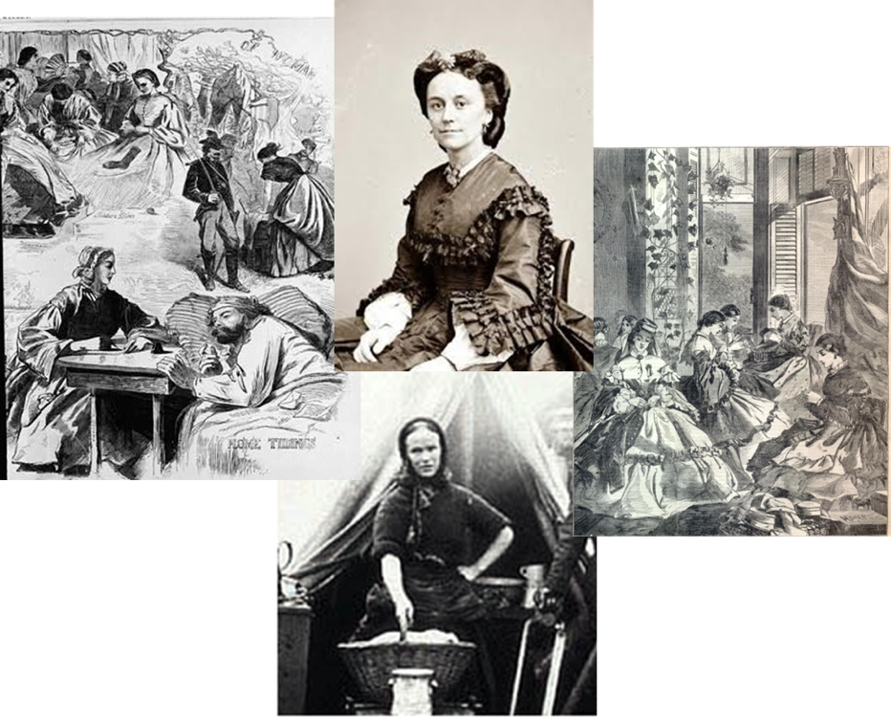
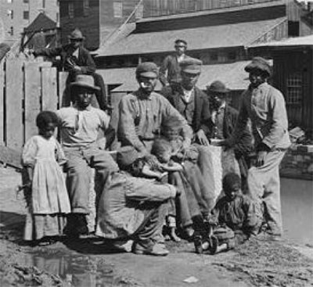
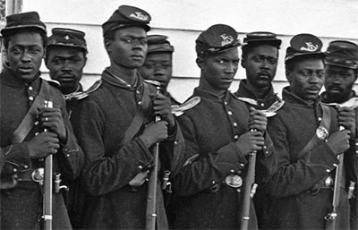
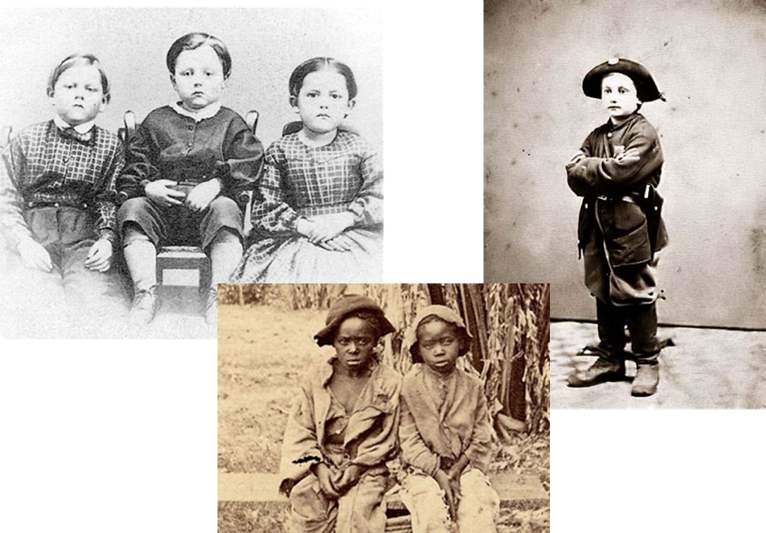
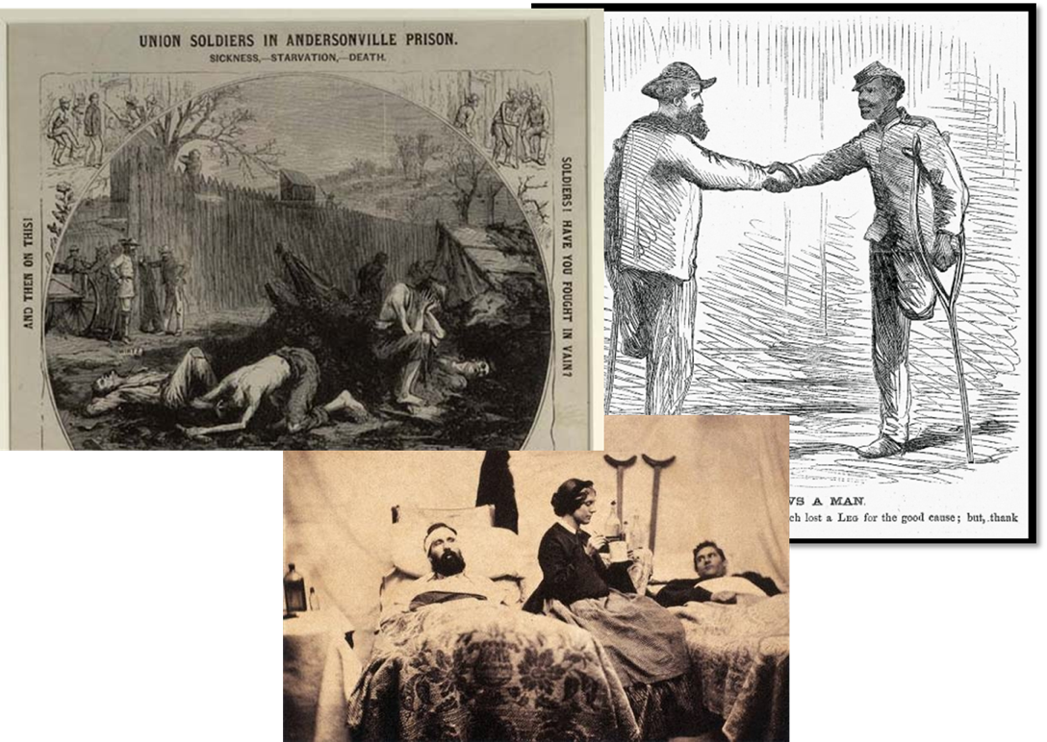
SOCIAL EFFECTS
Notes:
750,000 deaths in the CV – that means on average 504 people died per day. 2.5% of the population (which, if today that happened, would be 7 million). Most people died not from bullet wounds, but from infections -2/3 of deaths were from disease. Anaesthesia was developed during this time. Slave children found in NC attic; 54th regiment – what now?

Slide 28
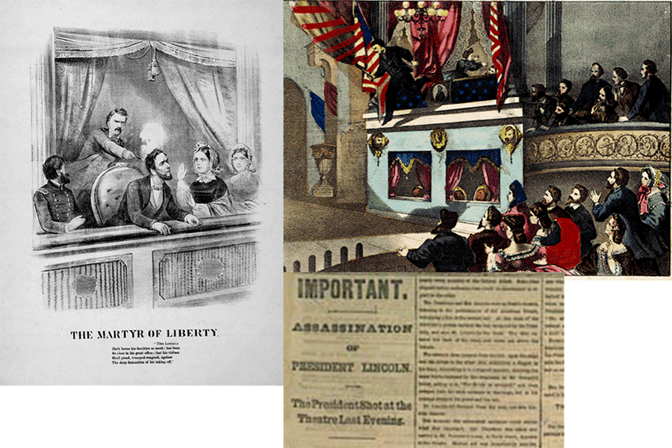
POLITICAL EFFECTS

Slide 29
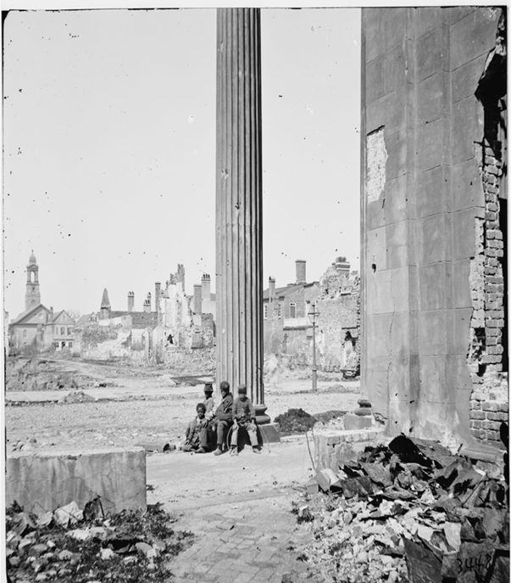
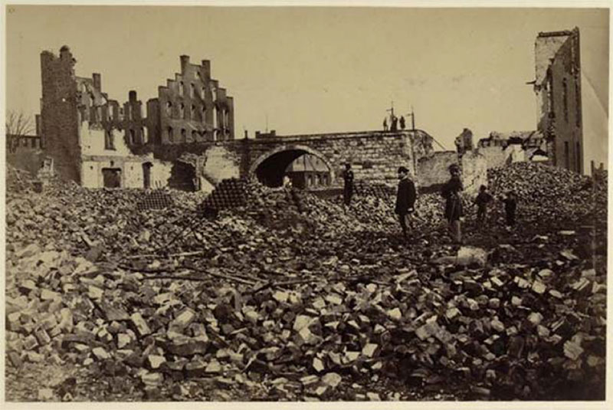
ECONOMIC EFFECTS

Slide 30
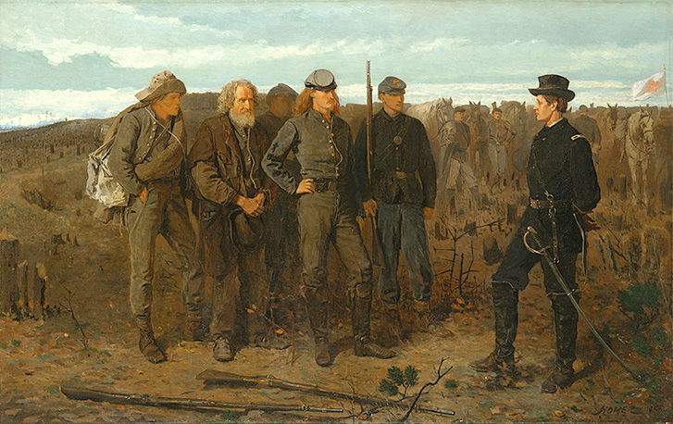
Notes:
It represents an actual scene from the war in which a Union officer, Brigadier General Francis Channing Barlow (1834–1896) captured several Confederate officers on June 21, 1864. The background depicts the battlefield at Petersburg, Virginia.

Slide 31
NOW WHAT?
What do you think former slaves expected?
Confederates?
Union supporters?
Notes:
Remember – people have been enslaved for 100s of years. What’s going to happen now that they’re free? Who is going to like this? What might people try to do??

Slide 32
AGENDA – 8/25
Turn in your ch 11 quick recap! Make sure your name is on it!
Fun historical artifacts!
Let’s have a chill day – let’s learn some notetaking skills. Or maybe let’s talk about current events. Or have a class discussion about your last exercise from yesterday. We will see where the wind takes us.
HOMEWORK: ch 12 study guide (continuous hw)
Notes:
Remember – people have been enslaved for 100s of years. What’s going to happen now that they’re free? Who is going to like this? What might people try to do??

Slide 33
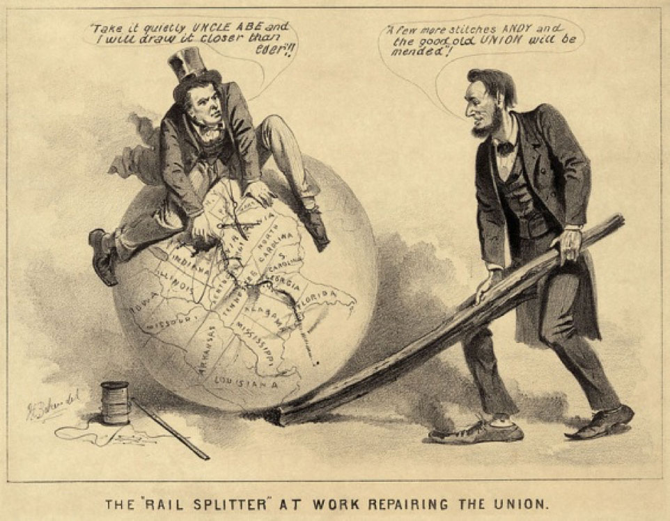
RECONSTRUCTION, 1865-1877
Other guiding questions:
- What people or objects are shown?
- What, if any, words do you see?
- Why were those words chosen?
What symbols are present?
What do they represent?
- What is the picture about?
Notes:
Groups of 5.

Slide 34
CREATING A PLAN FOR RECONSTRUCTION
Your goals are:
To reunite the nation, resolve the conflicts that led to the war, and heal the wounds the war caused
To bring justice to the nation and its citizens

Slide 35
CREATING A PLAN FOR RECONSTRUCTION
What will happen to each of the ex-Confederate groups listed below?
Will they be citizens? Will they be permitted to vote? Will they be permitted to hold office?
Confederate leaders
Wealthy, slave-owning planters
Women who ran plantation households
Low-ranking soldiers
Working-class and poor whites

Slide 36
CREATING A PLAN FOR RECONSTRUCTION
What will happen to freedpeople and other African Americans? Will they be citizens? Will they be permitted to vote and hold office? What other rights will they get?

Slide 37
CREATING A PLAN FOR RECONSTRUCTION
What will happen to the land confiscated by the Union army or abandoned during the war? Who has the right to use it? Who has the right to own it?

Slide 38
CREATING A PLAN FOR RECONSTRUCTION
What is the best way to ensure that white Southerners will be loyal to the United States and accept the end of slavery?

Slide 39
EVALUATE YOUR PLAN
Who are the winners and losers in your plan?
How will your plan help to reunite and heal the country?
How will your plan bring about justice after the war? Does it deny justice to any groups of Americans? What might that lead to?

Slide 40
RECONSTRUCTION
Learning target: How will people (men, women, whites, blacks) respond and adjust to life after war

Slide 41
AGENDA – 8/29
Lincoln vs. Johnson: plans for Reconstruction

Slide 42
RECONSTRUCTION
Learning target: How will people (men, women, whites, blacks) respond and adjust to life after war

Slide 43
AGENDA: 8/30
Warm up: “Good Ole Rebel”
Lesson: Responses to Reconstruction
Homework: Ch 12 study guide

Slide 44
WARM UP
Listen to “Good Ole Rebel”
As you listen, write down three words or phrases that describe Southern white attitudes toward Reconstruction
Notes:
((this was during the Redeemer phase - after congressional reconstruction when whites started to take back the south)

Slide 45
RECONSTRUCTION TIMELINE
Notes:
- reconstruction ended in 1877, when Hayes was elected president after he promised to remove military troops from the south (they were the only things protecting blacks and enforcing some kind laws)
- Then, 1877-1954: Jim Crow era - segregation, poll tax, literacy tests

Slide 46
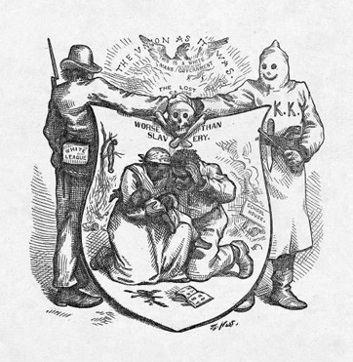
AFRICAN AMERICANS DURING RECONSTRUCTION
Immediately suppressed by whites, who disagreed with freeing the slaves
Passed Black Codes – laws that restricted freedoms and forced former slaves back into low paying jobs
Notes:
Black Codes – hand out worksheet

Slide 47
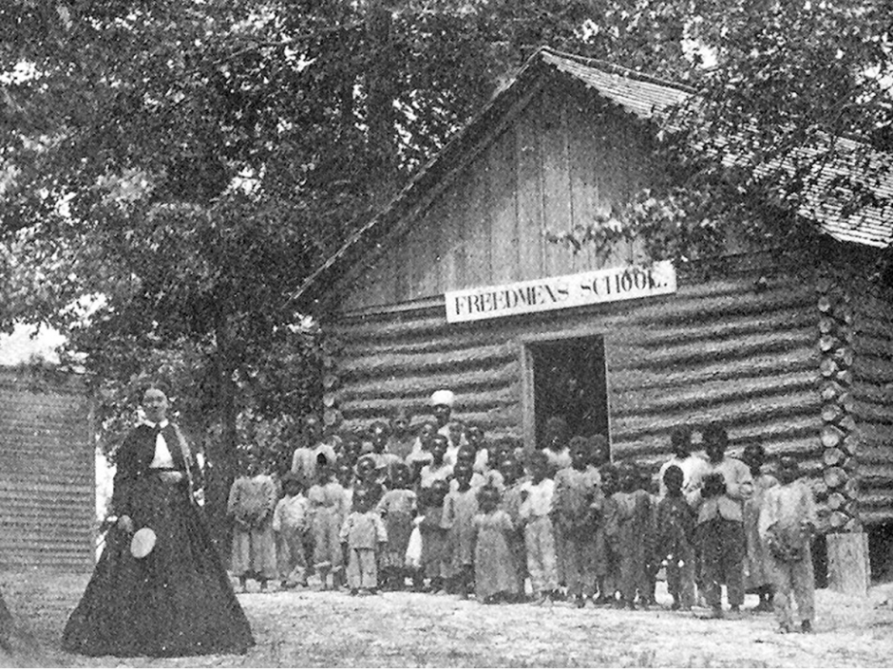
AFRICAN AMERICANS DURING RECONSTRUCTION
Very limited options due to Black Codes
Most returned to working on farms and plantations
Especially in the South, few had skills outside of manual labor… which will lead to the Freedmen’s Bureau
Provided food, housing, medical aid
Established schools
Offered legal assistance

Slide 48
THE RISE OF THE KKK
Notes:
- the KKK formed to put fear into freedmen in the south - lots of lynching and scare tactics - slowly, all states started shifting from Republican control to the Democratic party. Due to job restrictions, most slaves ended up farming again. that leads into sharecropping

Slide 49
LYNCHING
Learning target: How will people (men, women, whites, blacks) respond and adjust to life after war

Slide 50
AGENDA: 8/30
Warm up:

Slide 51
WARM UP
In your own words, define “lynching”
Consider: how is it different from murder?

Slide 52
LYNCHING
According to the NAACP:
there must be evidence that someone was killed;
the killing must have occurred illegally;
three or more persons must have taken part in the killing; and
the killers must have claimed to be serving justice or tradition.
Notes:
NAACP: National Association for the Advancement of Colored People

Slide 53
LYNCHING
? https://www.pbs.org/wnet/jimcrow/education_lesson7_steps.html
Notes:
NAACP: National Association for the Advancement of Colored People

