Slide 1
Lt 11/14: I will advise the president on an upcoming situation regarding National Security !
#WAR?
Warm up: what's the definition of imperialism in your own words!!!

Slide 2
QUICK DISCUSSION
We’ve talked about short-term and long-term effects of industrialization. With a partner, recap some of them.
What happens if you run out of natural resources?

Slide 3
QUICK DISCUSSION
We’ve talked about short-term and long-term effects of industrialization. With a partner, recap some of them.
What happens if you run out of natural resources?
Colonize a new place! Make new colonies! Or, build an empire…
IMPERIALISM!!
EMPIRE-BUILDING

Slide 4
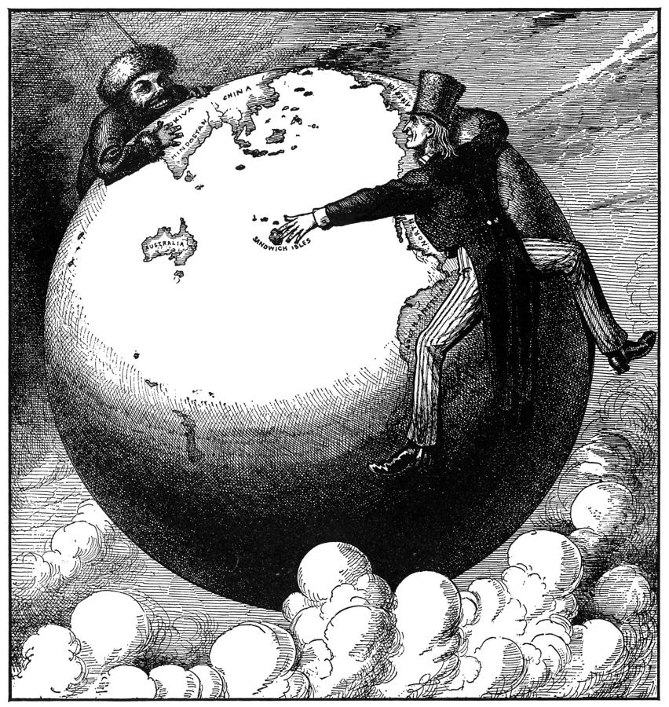
IMPERIALISM
EMPIRE-BUILDING

Slide 5
It is the late 1890s. You are all advisers to President William McKinley, there is a situation erupting in a nation that is close to the shores of the United States. To protect any possible assets at play, the name of the country has been changed to Poolandia.
The country that currently controls Poolandia will be called MotherVille.
Information is starting to come in piece by piece… it’s up to you to use the information and any possible notes you jot down to make informed decisions.

Slide 6
As members of the national security council you must give the president the best advice!
What should President McKinley do?

Slide 7
Since the 1500s, Poolandia is controlled by Motherville
There have been many attempts at independence by Poolandia, mainly in the mid to late 1800s
  Their fights for independence have been increasing over time
1895 – Poolandia fights their second war for independence
  They are trying TO GAIN INDEPENDENCE FROM MOTHERVILLE!
The colony is quickly becoming destabilized, and violence is wreaking havoc across the land.. And American assets (farms! People!) are in the colony.
  The increasing violence threatens American farms
1. What course of action will you take? Why?
  1. Sit and wait for more information
  2. Mobilize troops as a show of force
  3. Reach out to mother country (Motherville) to end it diplomatically.

Slide 8


Slide 9
Shipping firms that had relied heavily on trade with Poolandia are suffering losses as the conflict continued unresolved.
  The war for independence is ravaging the island and causing economic problems for the US!
These firms are pressing us to end this revolt. American money, lives, and land are all at risk!
Several Americans have already been kidnapped in Poolandia.
However, we do not want a war. We want to peacefully resolve these issues.
2. What course of action will you take? Why?
  1. Negotiate with Poolandia’s people who are fighting for independence
  2. Send a warning letter to Poolandia, denouncing the violence
  3. Continue diplomatic procedures with Motherville to stop the disturbance
  4. Do nothing.

Slide 10
Motherville sends in a general – General Weyler - to bring peace to the country.
  General Weyler has years of experience of ending conflict, but… he’s not the nicest dude
He has rounded up the population and put them into camps, called “reconcentrados”
  He believes this will weed out the rebels and the innocent citizens.
3. What course of action will you take? Why?
  1. Denounce this relocation (say this is bad and wrong!)
  2. Sit and wait for more information

Slide 12
URGENT URGENT URGENT TELEGRAM COMING IN!!!
300,000 Poolandian citizens moved into such "relocation camps.” Stop.
Many taken from country side into city. Stop.
Not enough provisions. Stop.
People dying by thousands. Stop.
Hunger, disease, starvation. Stop.
Weyler is ruling with Iron Fist. Stop.
Poolandian people in danger. Stop.
Jot down some notes that might help you make a decision later on

Slide 13
Secretary of the Navy John D. Long
As a Congressman I had become a close friend of William McKinley, who was elected President in 1896. Now, Mr. President; this situation needs to be taken care of quite delicately. Unlike my understudy Mr. Roosevelt who believes we need to intervene, I strongly believe in getting all the facts. I believe that this ongoing tensions between Motherville and US will unlikely lead to war, and should it, that the war would be easily won. Our army is in tatters since the end of the Civil War, we lack sufficient men and even worse sufficient goods, rifles, and munitions and it will take time to gather such. I do have a rough plan of attack scuttled out if needed.
4. What course of action will you take? Why?

Slide 14
American public starting to get involved.
  William Randolph Hearst and Joseph Pulitzer are stirring up articles and columns left and right.
  They are demanding action!
Many American citizens are drawing a conclusion of our American Revolution:
  Poolandia is trying to declare its independence.
  Motherville seen as evil colonial oppressor.
5. What course of action will you take? Why?
  1. Make a public speech denouncing the actions of Weyler and Motherville
  2. Start making plans for US assistance to Poolandia
  3. Continue on the diplomatic channel to avoid bloodshed

Slide 15
Motherville recalls Weyler due to his violence
Motherville has attempted to make some changes
January 25, 1898. USS Maine Arrives.
  USS Maine is there for simply “friendly visit”… or is it?
  In order to protect US citizens and US interests in Poolandia, U.S.S Maine – a battleship - sent to anchor in the main bay of Poolandia.

Slide 17
URGENT URGENT URGENT TELEGRAPH INCOMING.
Our intelligence committee intercepted a letter from the ambassador of Motherville to Poolandia.
February 9th 1898
“Besides the ingrained and inevitable bluntness with which is repeated all that the press and public opinion in Motherville have said about Weyler, it once more shows what McKinley is: weak and a bidder for the admiration of the crowd besides being a would-be politician who tries to leave a door open behind himself.”
5. Course of Action and why?

Slide 19
URGENT!!!!
•February 15th 1898, we receive reports of an explosion sinking the U.S.S Maine. 250 sailors dead.
•Early reports indicating that the explosion was from a bomb placed by Motherville agents. The public is in a frenzy and are clamoring for war.
Course of Action and why?
  1. Declare War
  2. Other Option?

Slide 20
URGENT!!!!
Update: the situation in another Motherville colony, Poolippines, is also becoming more serious.
Rebels have been attacking the Motherville government there.
This could present a good opportunity for the US…
Course of Action and why?
  1. Declare War
  2. Other Option?

Slide 21
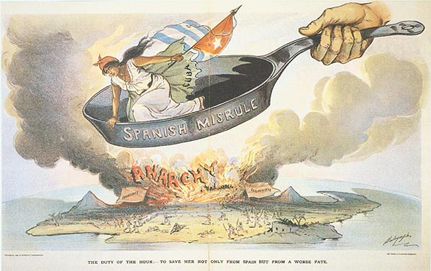
SPANISH-AMERICAN WAR
1898, the USA gets involved in a war with Spain in Cuba – why?

Slide 22
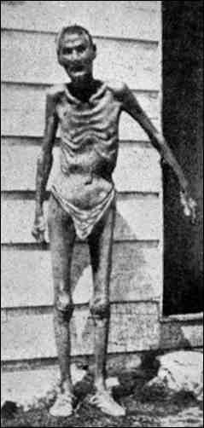
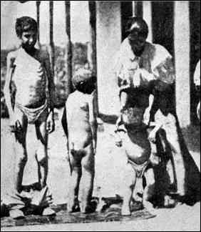
SPANISH-AMERICAN WAR
Cuban Revolution against Spain
Jose Marti – burned plantations; threat to American industry in Cuba
  To get US to join?
  Or why?
Spain against Cuban rebels – Valeriano Weyler
  Reconcentrados

Slide 23
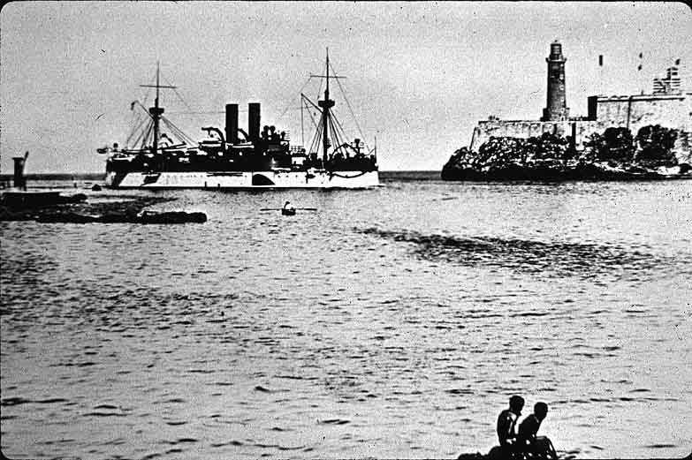
USS Maine
American citizens threatened by revolution in Cuba.
Pres. McKinley sent USS Maine to rescue US citizens.

Slide 24
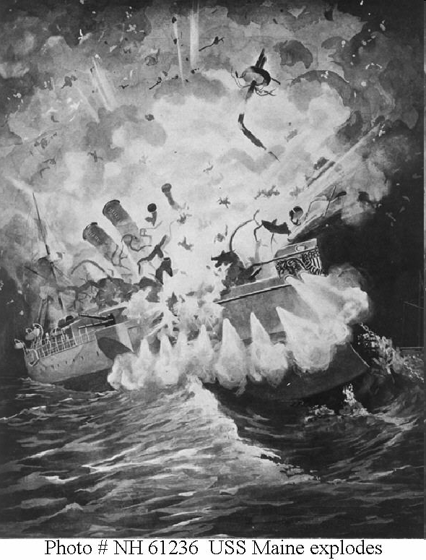

Slide 25
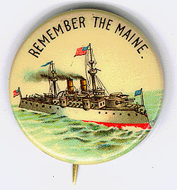
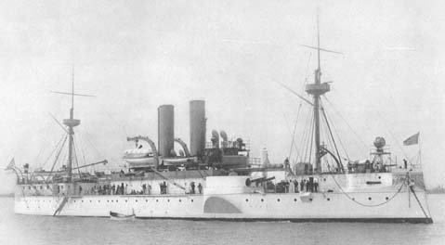
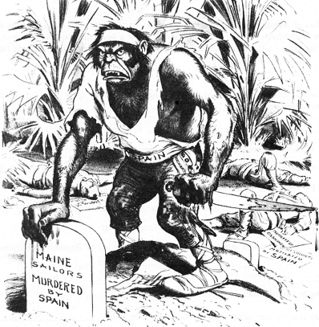
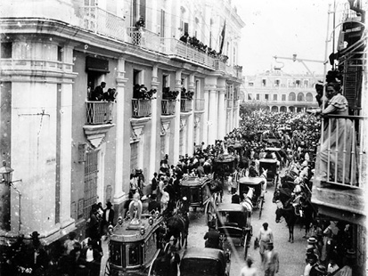
Remember the Maine
and to Hell with Spain!
The USS Maine explosion becomes justification for US entrance into war

Slide 26
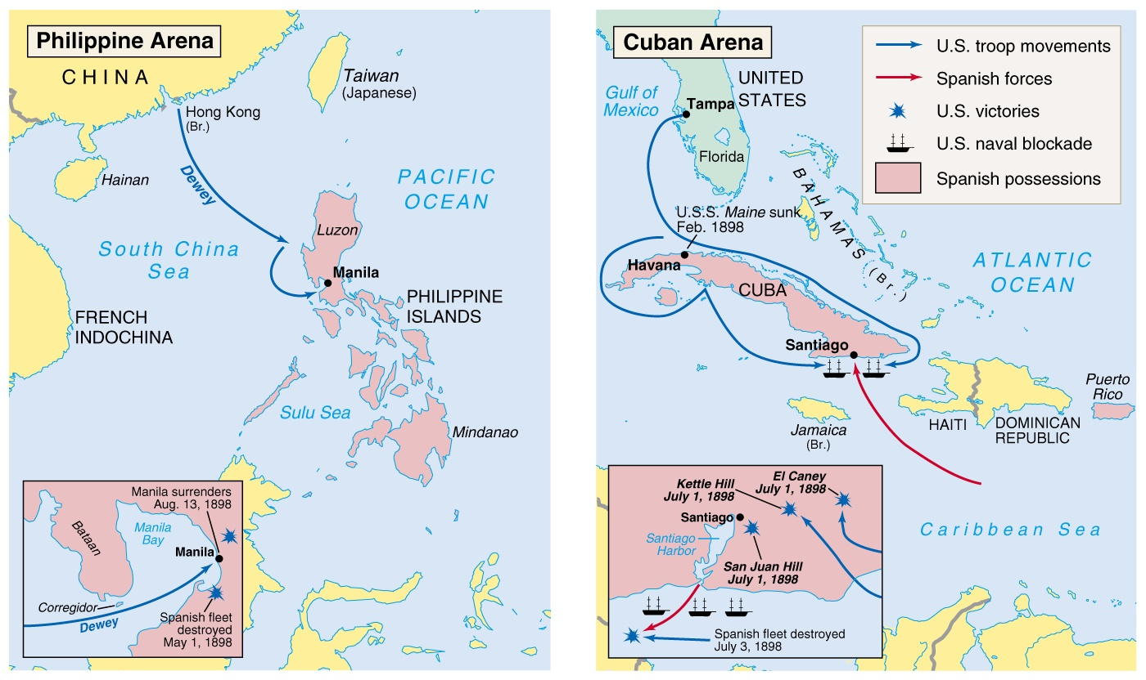
SP War in Pacific

Slide 27
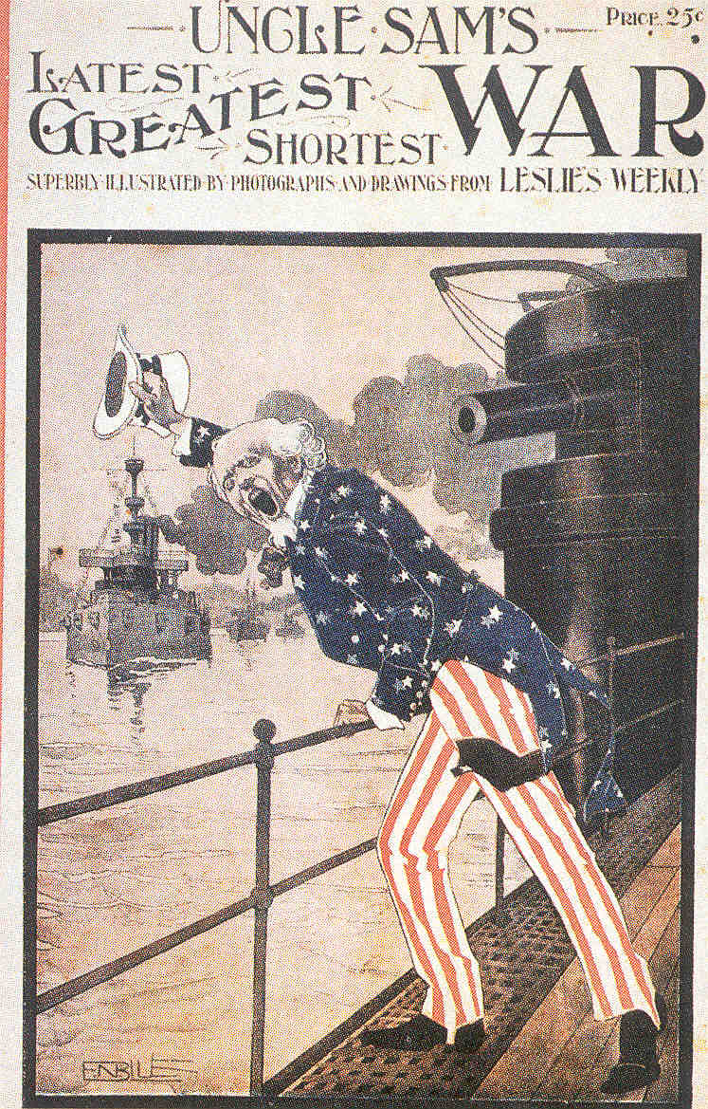
EFFECTS OF THE SPANISH-AMERICAN WAR
US becomes a world power
  Cost of war in $ and loss of life was minimal
  “A splendid little war” – Sec. of State John Hay
Through Treaty of Paris, gained: Philippines, Guam, Puerto Rico

Slide 28
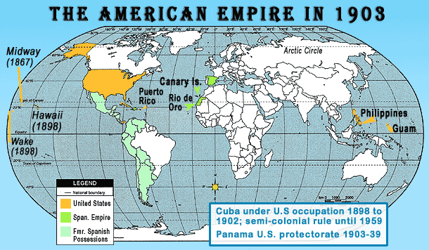

Slide 29
YELLOW JOURNALISM
Aka, the original #fakenews
How long shall Cuban women be the victims of Spanish outrages and lie sobbing and bruised in loathsome prisons?
How long are the Spaniards to drench Cuba with the blood and tears of her people?
How long shall old Cuban men and women and children be murdered by the score, the innocent victims of Spanish rage against the patriot armies they cannot conquer?
How long shall the U.S. sit idle and indifferent within sound and hearing of rape and murder?
HOW LONG?

Slide 30
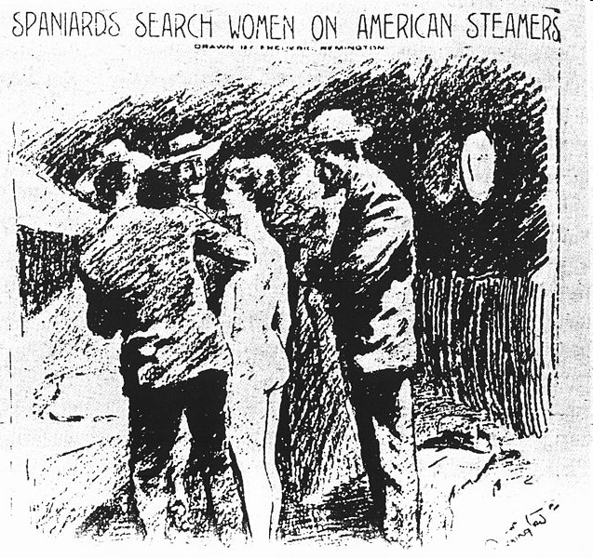

Slide 31
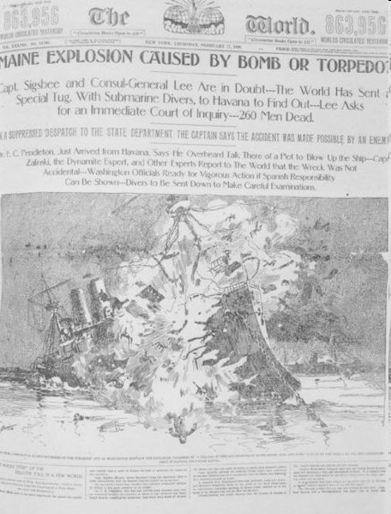

Slide 32
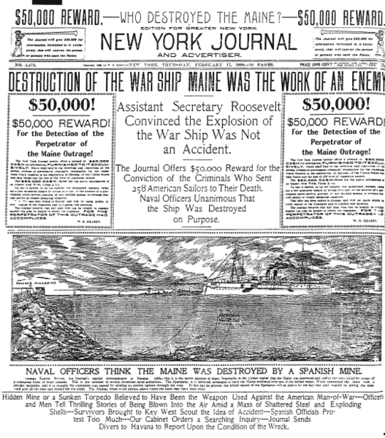

Slide 33
Homework!
Ch 18 Sec 2 – the Spanish American War
Letter for the USJ – extra credit!! – due on Monday
  2 paragraphs
    1 over issue
    1 over proposed solution
  Please email it to me ☺
  And print out a hard copy

