Slide 1
Agenda
Hand back test – written responses
Intro to the Industrial East!

Slide 2
 | 3 pts | 2 pts | 1 pt | 0 pts
Claim |  | Correct, specific, direct answer | Correct answer | Does not answer the question / answer is incorrect
Evidence | Correct, specific evidence to support answer | Correct, general evidence to support answer | Incorrect or vague evidence to support answer | No evidence provided
Explanation of the how/why the evidence | Evidence is fully explained in relation to answer (explains about the how/why) | Explanation is attempted, but is not fully articulated or coherent | Incorrect explanation of evidence | No explanation of evidence

Slide 3
Warm up
In your notebook:
Identify and explain one motivation that led people to expand westward. (CER!)
Identify and explain one conflict that existed in the West. (CER!)

Slide 4
Warm up
What’s going on in the East?

Slide 5
THE INDUSTRIAL EAST
A brief overview!

Slide 6
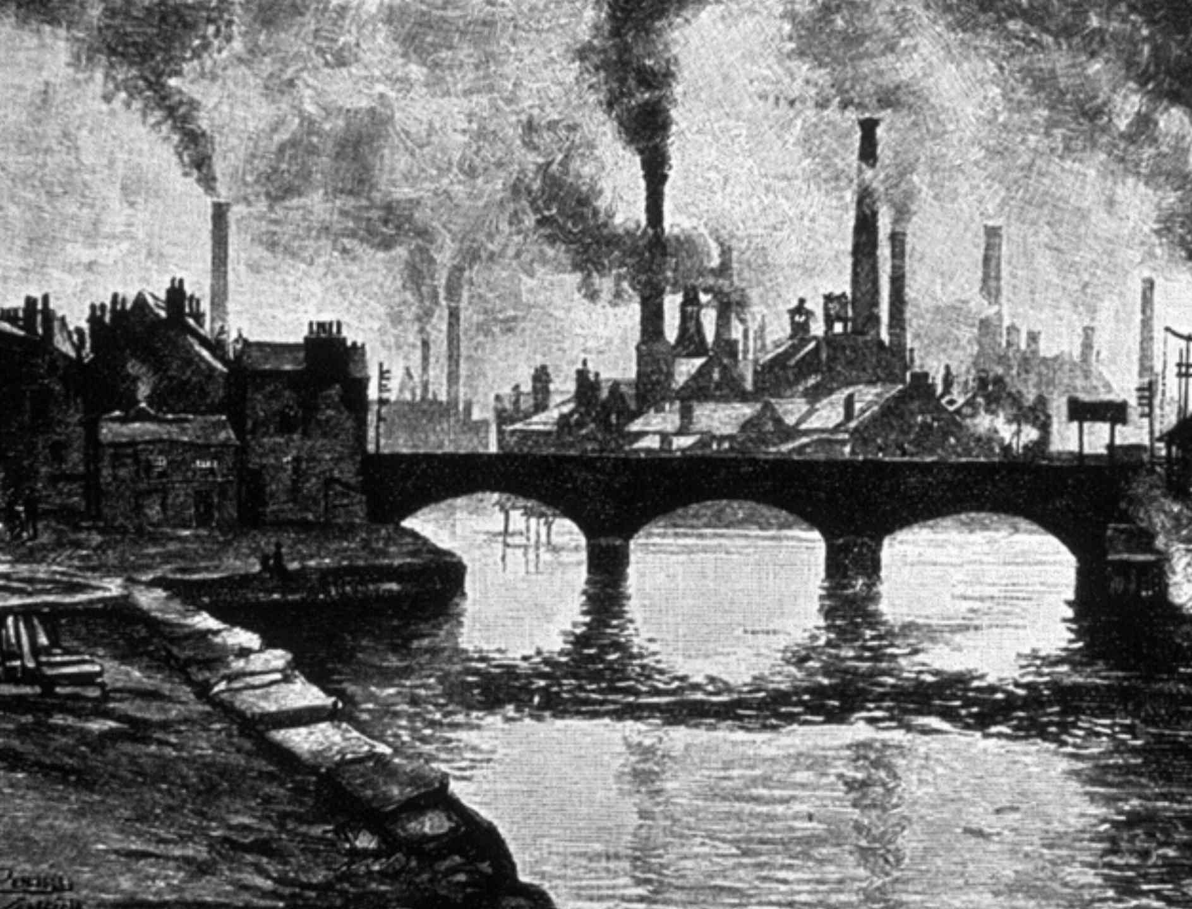
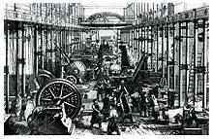
What was the Industrial Revolution?
New manufacturing process that used machines (rather than humans)
Helped end slavery!!!!!

Slide 7
What was the Industrial Revolution?
What resources did the US need to fuel its industry?
Notes:
Oil, coal, iron

Slide 8
What was the Industrial Revolution?
What were benefits that came about as a result of the Industrial Revolution?
What were detriments?

Slide 9
What was the Industrial Revolution?
Pros:
Increased production → lowered costs of goods
New technologies!

Slide 10
Cons: SHORT-TERM EFFECTS
Things got really bad really quickly

Slide 11
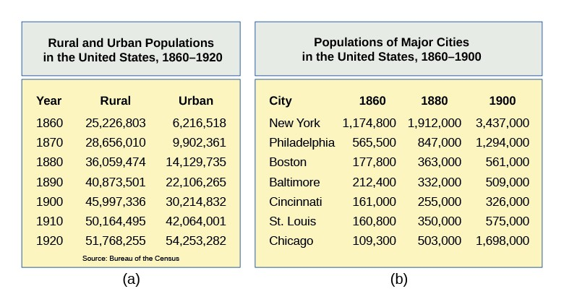
Urbanization
What problems may arise as a result of this?
Notes:
What are going to be problems faced by those moving into the cities for work? – overcrowding, disease, etc

Slide 12
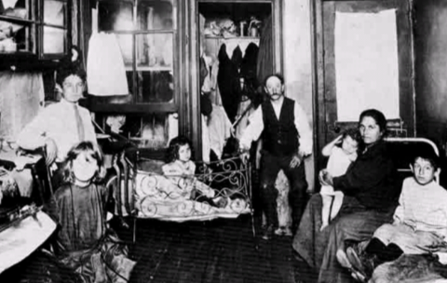
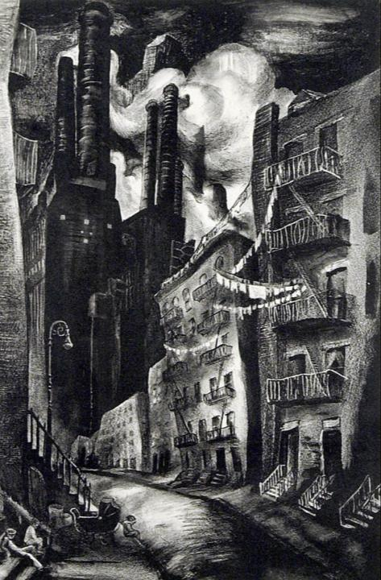
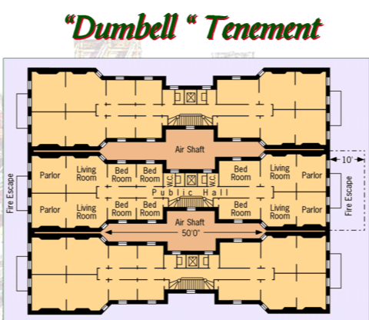
Notes:
Lots of families crammed into tenements – usually right near factories; pollution terrible

Slide 13
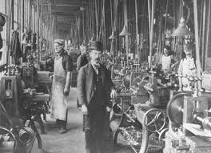
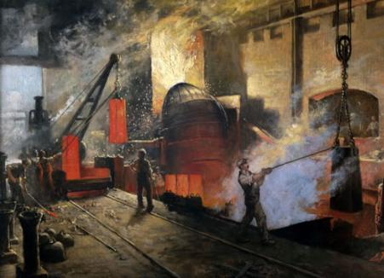
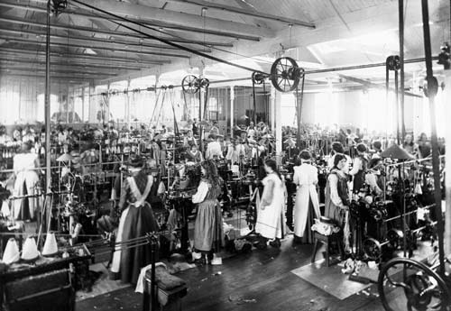
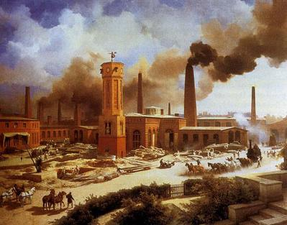

Slide 14
Working Conditions and Wages
Factory system
Conditions were dirty, dangerous, and unhealthy
….coal mines, anyone?
Long hours (10-16 hrs)
Not paid well (women and children less than men for same work)

Slide 15
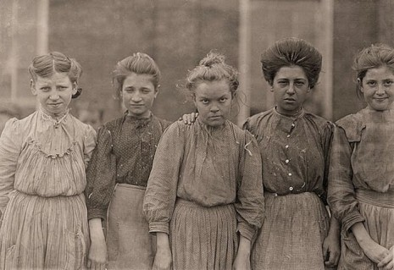
QUICK DISCUSSION:
Why would women and children need to work?

Slide 16
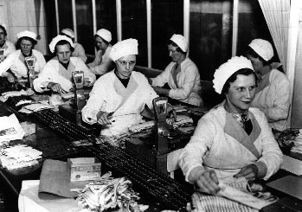
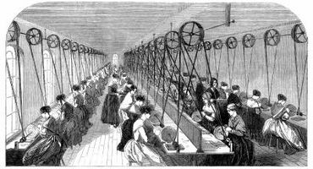
Women in the Workforce
Factory jobs to support their family
Paid half or a third of an adult male’s salary

Slide 17
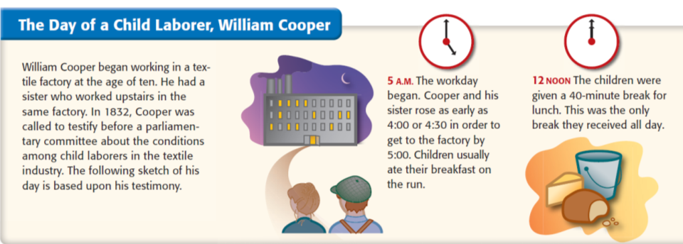
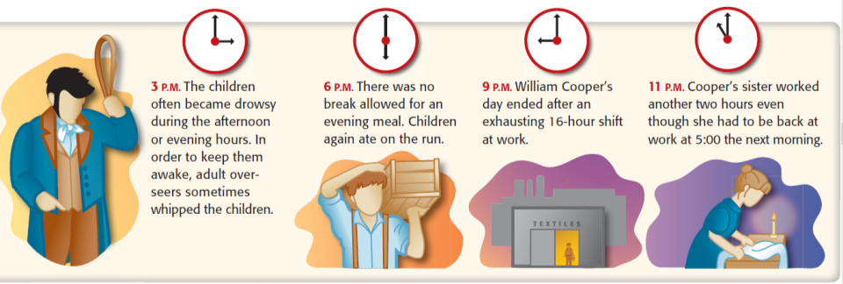
Child Labor
Notes:
Why would kids need to work? BC urbanization! Too expensive to live in cities

Slide 18
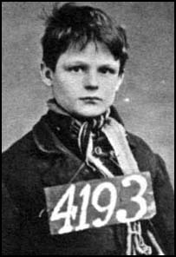
Child Labor
Earned 10% of an adult male’s wage
Accidents were commonplace
A visitor to England commented that he had seen so many people in the streets without arms and legs that it was like "living in the midst of the army just returned from a campaign."
Notes:
Those late for work were severely punished
They were hit with straps to work faster
Some children were dipped head first into a water cistern if they became drowsy
Talking to other children was forbidden

Slide 19
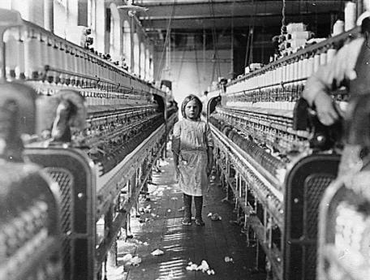
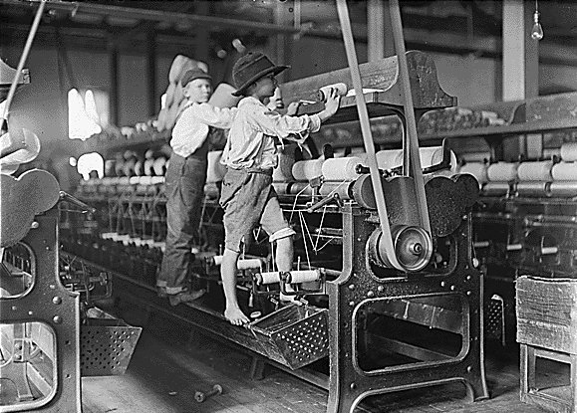
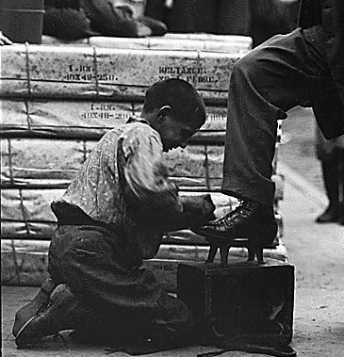
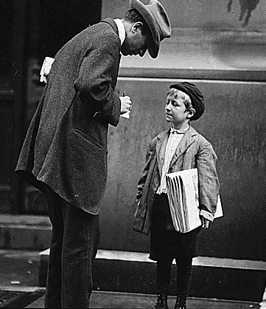
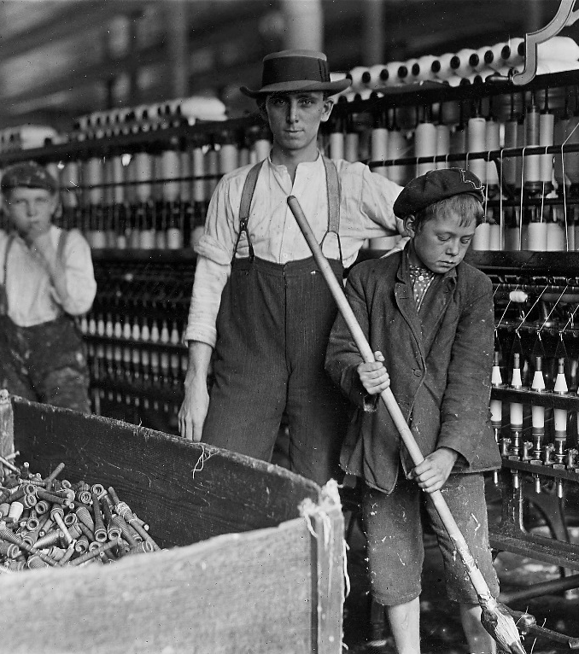

Slide 20
Worker’s Ages in Cotton Mills
Age Male Female
Under 11 246 155
11-16 1169 1123
17-21 736 1240
22-26 612 780
27-31 355 295
32-36 215 100
37-41 168 81
42-46 98 38
47-51 88 23
52-56 41 4
57-61 28 3
http://www.dailymotion.com/video/x2m0xbq

Slide 21
QUICK DISCUSSION
Life is hard and tiring for factory workers… what’s life like for factory owners?

Slide 22
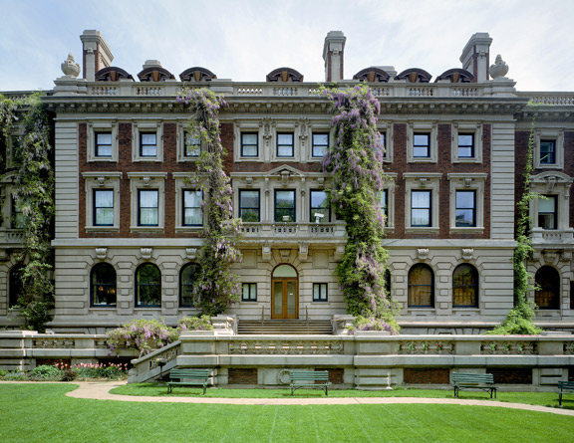
How Andrew Carnegie lived…

Slide 23
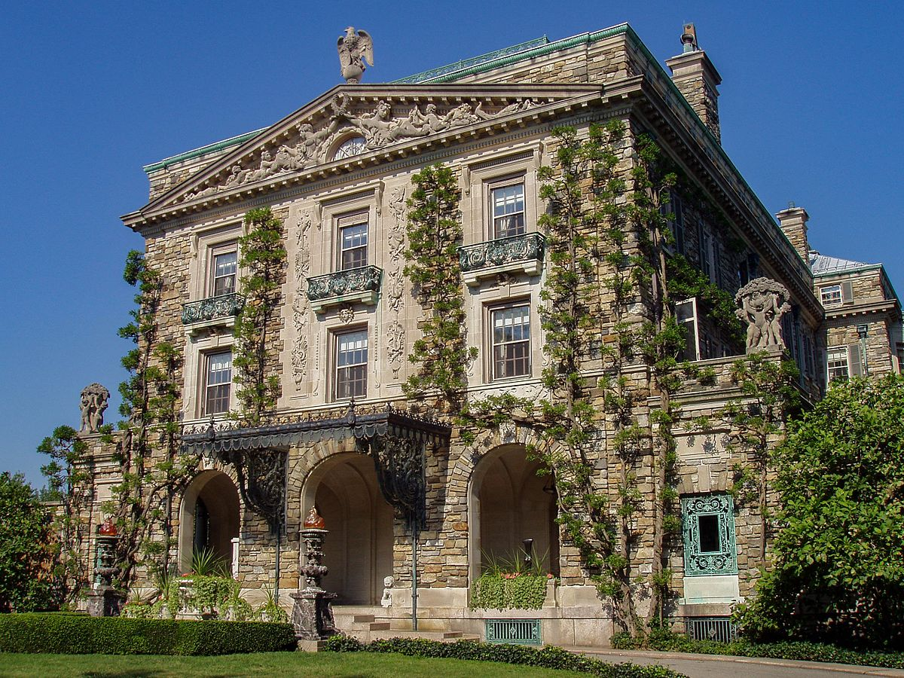
How JD Rockefeller lived…

Slide 24
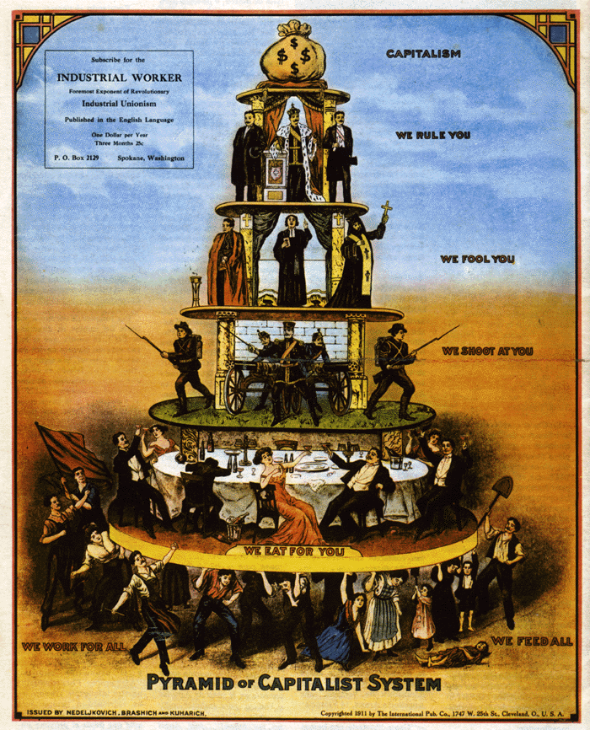
Social Hierarchy Shift
Wealth pyramid:
Factory owners
Engineers, managers, shopkeepers
Urban poor (factory workers)

Slide 25
Rest of class:
General overview of the industrial revolution in the USA
Two specific documents about child labor
Read and answer questions!
Would you rather be in school or rather work on a factory? Why?
If time, crash course!

Slide 26
Warm up
What were the negative effects of the Industrial Revolution?

Slide 27
Long-term effects: positive things!
The short term effects were pretty bad! But the long term effects were good!

Slide 28
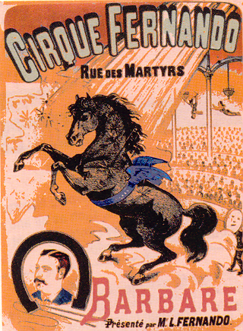
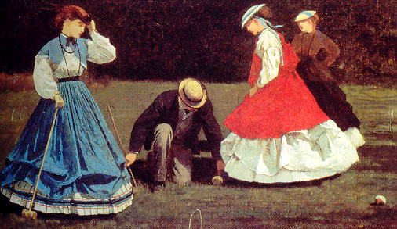
Leisure
By the 1900s, more money + more free time = more fun!
Disposable income due to minimum wage
Free time due to shortened work day
This leads to a consumer culture in the US
Notes:
Once they figured out an 8 hour work day and minimum wage, people had disposable income.

Slide 29
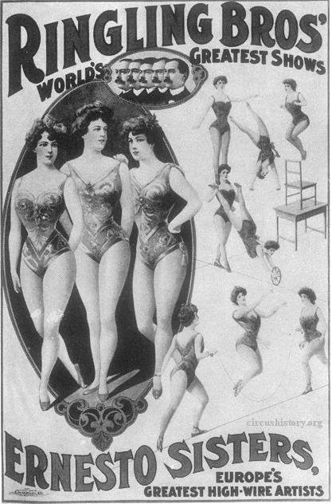
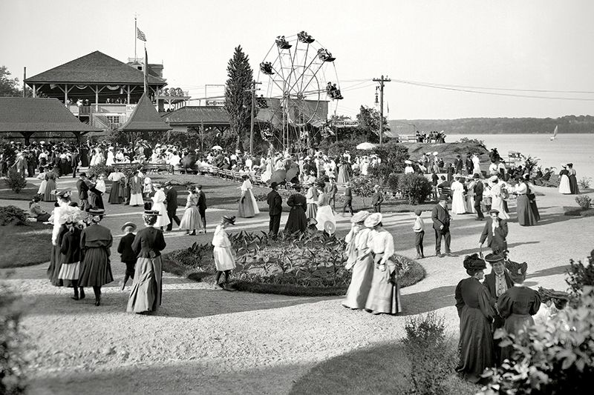
Mass Culture
Amusement Parks
Roller coasters and Ferris wheels
Circuses
Notes:
Once they figured out an 8 hour work day and minimum wage, people had disposable income.

Slide 30
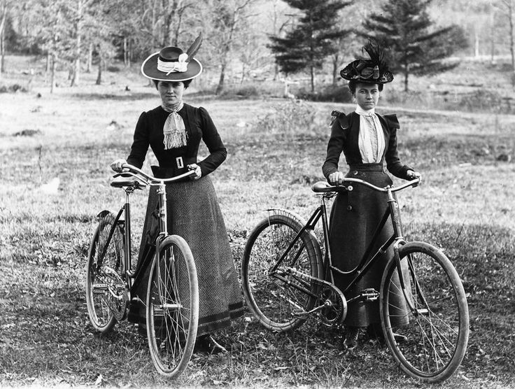
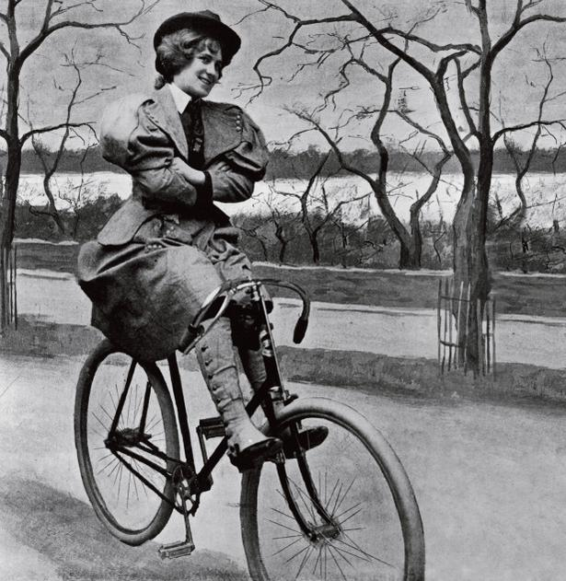
Mass Culture
Bicycles
Led to women wearing ‘split skirts’ on a regular basis!
“I think bicycling has done more to emancipate women than anything else in the world. … it gives women a feeling of freedom and self-reliance.” – Susan B. Anthony
Notes:
Once they figured out an 8 hour work day and minimum wage, people had disposable income.

Slide 31
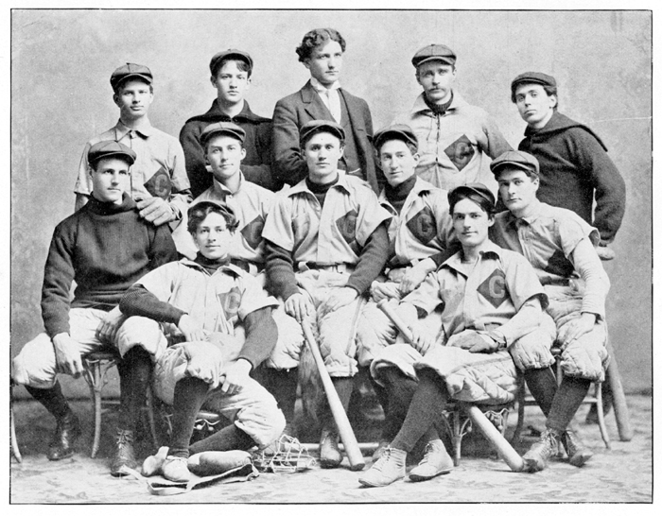
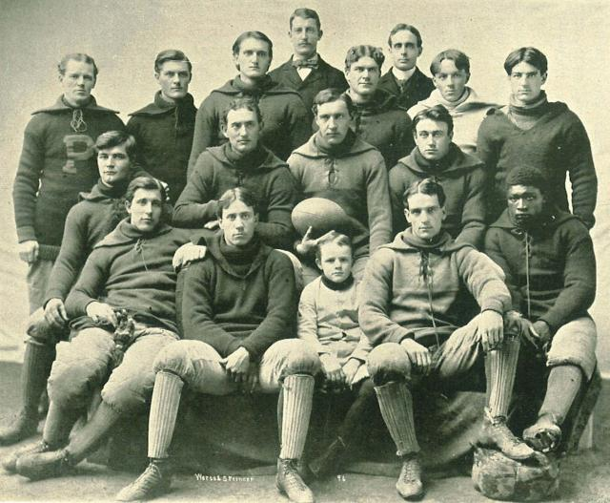
Mass Culture
Spectator sports – baseball, boxing, football
Operas, theaters, museums
Notes:
Once they figured out an 8 hour work day and minimum wage, people had disposable income.

Slide 32
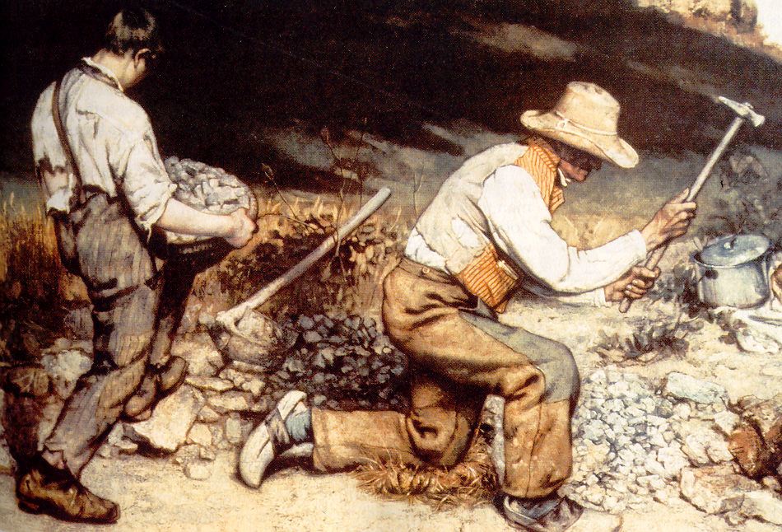
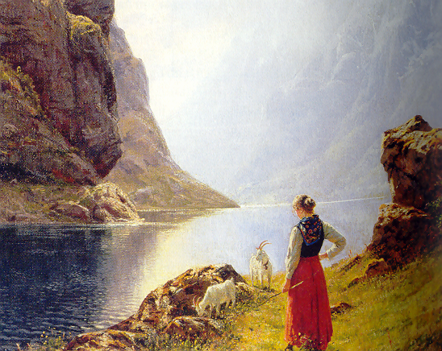
Mass Culture
Realism and Romanticism in artwork
Art schools

Slide 33
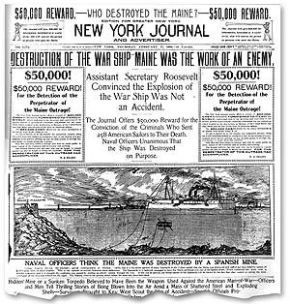
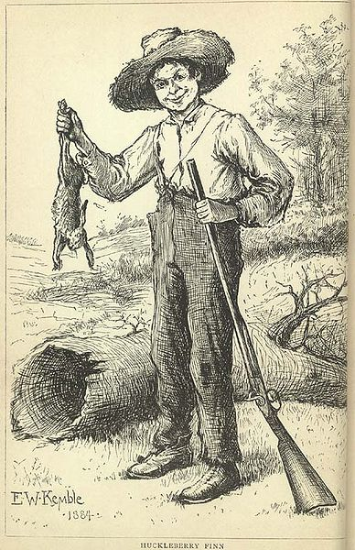
Mass Culture
Newspapers – Joseph Pulitzer; William Randolph Hearst
Fiction – Mark Twain

Slide 34
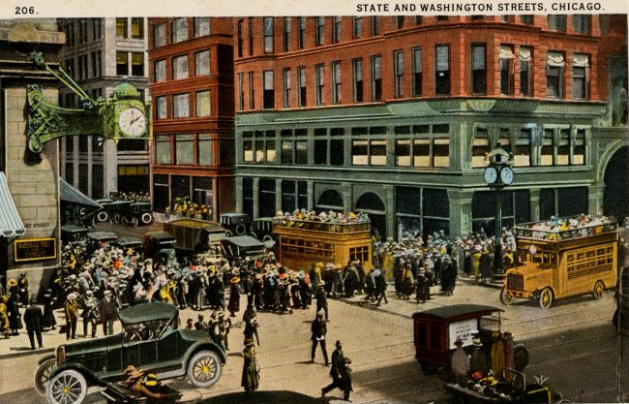
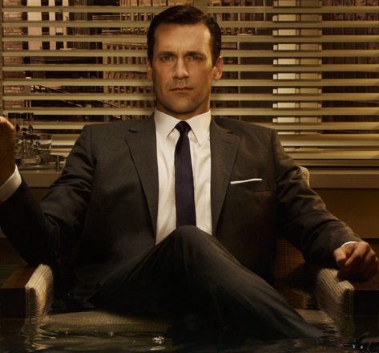
Mass Culture
Shopping centers, malls, and chain stores
Advertising

Slide 35
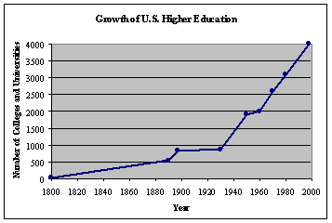
Public Education
By 1895, most states passed laws requiring 12 to 16 weeks annually of school attendance for students aged 8-14
High schools
Colleges and universities

Slide 36
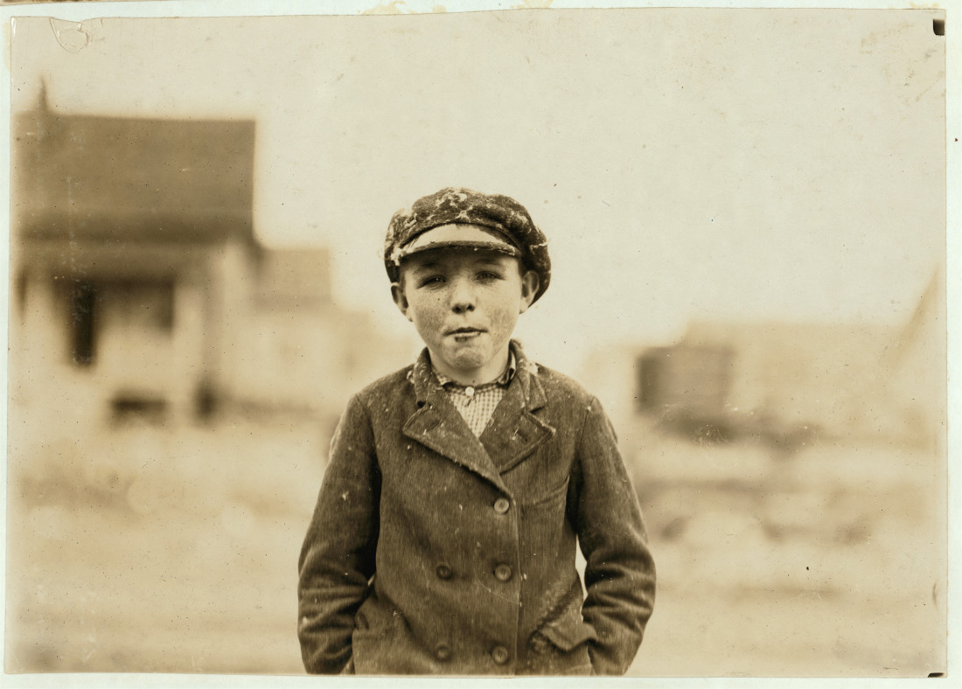
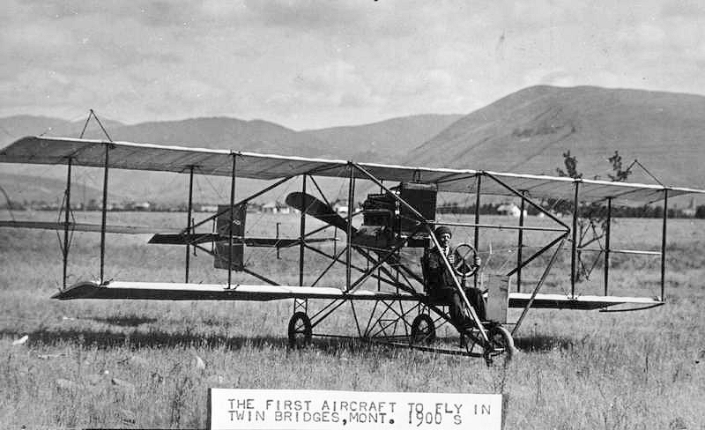
New Technology
Airplanes
More advanced printers
Skyscrapers
Transit
Photography

Slide 37
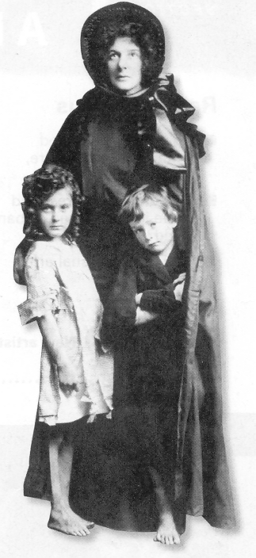
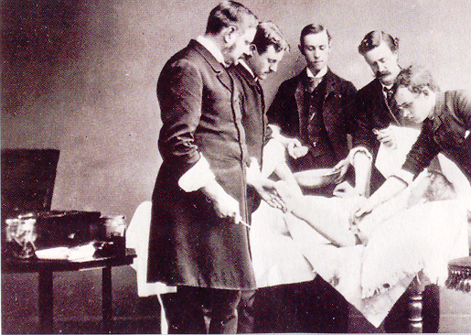
Health & Welfare
Smallpox vaccine
Penicillin
Antiseptics
Salvation
Army

Slide 38
Agenda – 9/18
Sweatshops!?!?!?
Two different perspectives
HW: read about immigration!

Slide 39
Warm up
Do “sweatshops” exist still today?
a factory or workshop, especially in the clothing industry, where manual workers are employed at very low wages for long hours and under poor conditions.

Slide 40
Warm up
Why do “sweatshops” exist still today?
a factory or workshop, especially in the clothing industry, where manual workers are employed at very low wages for long hours and under poor conditions.

Slide 41
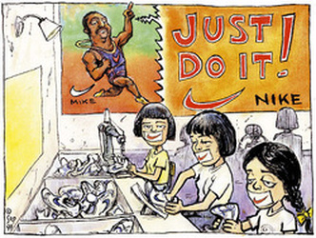

Slide 42
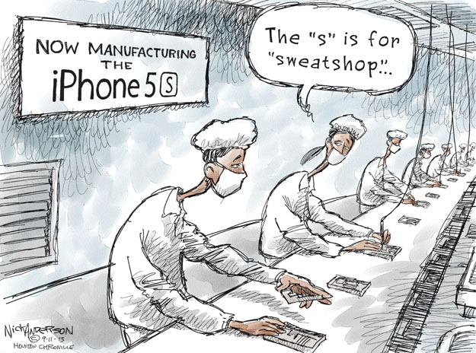

Slide 43
QUICK DISCUSSION
How did people respond to the changes and abuses of the Industrial Revolution?
How would you respond if you were in those situations?

Slide 44
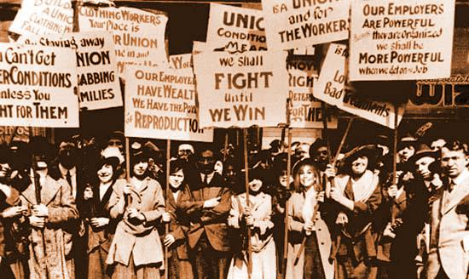
How did people respond to the changes and abuses of the Industrial Revolution?

Slide 45
How did people respond to the changes and abuses of the Industrial Revolution?
USA passed child labor and women labor laws
Reformers regulated living and working conditions
Workers formed unions

Slide 46
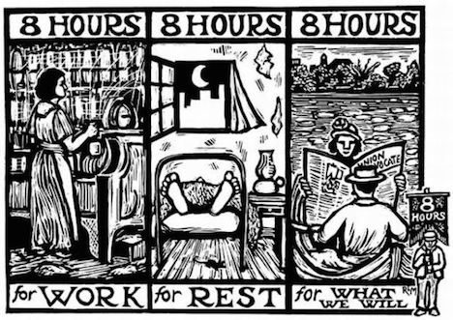
How did people respond to the changes and abuses of the Industrial Revolution?
Unions:
Workers join together to fight against injustices and wrongs
Strikes and protests
Does this exist in the West?

Slide 47
How did people respond to the changes and abuses of the Industrial Revolution?
Unions:
American Federation of Labor (AFL)
Strikes allowed them to win shorter workweeks and higher wages
Industrial Workers of the World (IWW)
Socialist organization – share the wealth; take away riches from the factory owners

Slide 48
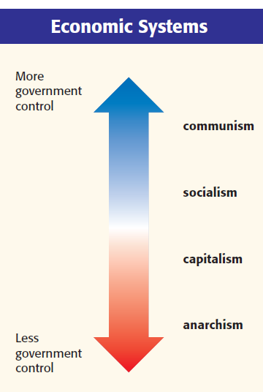
How did people respond to the changes and abuses of the Industrial Revolution?
Growing gap between rich and poor made people mad
New economic philosophies
Socialism and communism
Government controls and plans the economy

Slide 49
LONG-TERM EFFECTS
ENOUGH DEPRESSING STUFF; LET’S DISCUSS HAPPY IMPACTS

Slide 50
Leisure
By the 1900s, more money + more free time = more fun!
Disposable income due to minimum wage
Free time due to shortened work day
This leads to a consumer culture in the US
Notes:
Once they figured out an 8 hour work day and minimum wage, people had disposable income.

Slide 51
Mass Culture
Amusement Parks
Roller coasters and Ferris wheels
Circuses
Notes:
Once they figured out an 8 hour work day and minimum wage, people had disposable income.

Slide 52
Mass Culture
Bicycles
Led to women wearing ‘split skirts’ on a regular basis!
“I think bicycling has done more to emancipate women than anything else in the world. … it gives women a feeling of freedom and self-reliance.” – Susan B. Anthony
Notes:
Once they figured out an 8 hour work day and minimum wage, people had disposable income.

Slide 53
Mass Culture
Spectator sports – baseball, boxing, football
Operas, theaters, museums
Notes:
Once they figured out an 8 hour work day and minimum wage, people had disposable income.

Slide 54
Mass Culture
Realism and Romanticism in artwork
Art schools

Slide 55
Mass Culture
Newspapers – Joseph Pulitzer; William Randolph Hearst
Fiction – Mark Twain

Slide 56
Mass Culture
Shopping centers, malls, and chain stores
Advertising

Slide 57
Public Education
By 1895, most states passed laws requiring 12 to 16 weeks annually of school attendance for students aged 8-14
High schools
Colleges and universities

Slide 58
New Technology
Airplanes
More advanced printers
Skyscrapers
Transit
Photography

Slide 59
Health & Welfare
Smallpox vaccine
Penicillin
Antiseptics
Salvation
Army

Slide 60
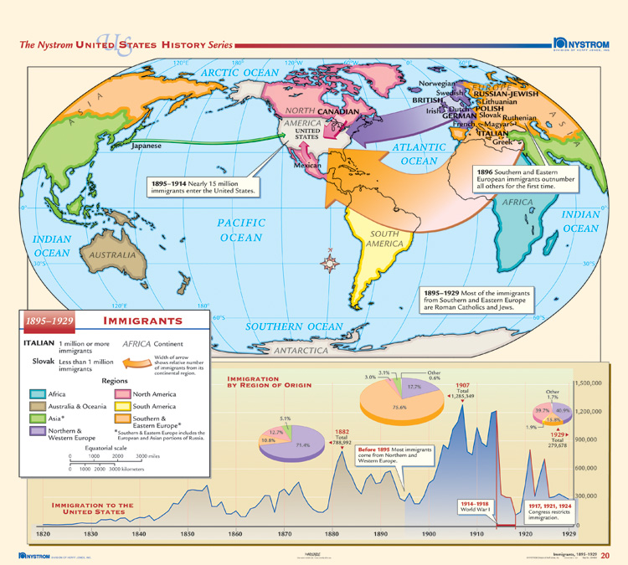
Immigration to the United States

Slide 61
Reflection Questions
What social, economic, and environmental changes occurred as the US industrialized?
Make a thinking map!

Slide 62
Reflection Questions
Denver is experiencing rapid urbanization. What are some similarities that you experienced in the game that you see presently in Denver? What is different?

Slide 63
Short Answer Questions
“Identify and explain ONE effect of the Industrial Revolution.”
ACE
Answer. Cite. Explain.
** when I say “cite,” I don’t mean cite a textbook. I mean provide evidence. But ACE is way cooler than APE. ☺
Sentence stems!
“One environmental effect of industrialization was _____. For example, _____. This was an effect because _____.”
PEEL
Point. Evidence. Explain. Link back to prompt.

Slide 64
Closure
Respond to one of the two prompts. Your response should be at least a five-sentence paragraph.
Do you think we’re undergoing a new revolution?
What would it be called?
How will it impact society?
What will history books write about your generation?
Did the Industrial Revolution have more positive or negative consequences?
Were the short-term atrocities negated by the long-term impacts?

