Slide 1
Agenda: 8/16
Today: Jared Diamond readings and notetaking skills
HW due TOMORROW:
read and take notes over p 35-38
SPICE chart of the US
complete in your notes, not on a separate sheet of paper

Slide 2
Guns, Germs, and Steel by Jared Diamond
Diamond is a physiologist, ecologist, geographer, biologist, anthropologist, and author who wanted to answer a big question:
Why did Eurasia “win” history? What factors helped Europe and Asia dominate the rest of the world?

Slide 3
How to read for understanding and how to take good notes
If you are not going to annotate your reading: read with your pencil down
If you are going to annotate your reading: star main ideas, or come up with symbols that will help you understand what you’re reading
Define vocab words
Summarize the main idea of each section in your own words
What a great check for understanding!
It might take you more time upfront as you’re getting used to it, but it will save you so much time in the long run. I promise.

Slide 4
In your groups…
Come up with a hypothesis (guess) for his question.
What factors do you think helped Europe and Asia (also called Eurasia) dominate the rest of the world throughout most of history?

Slide 5
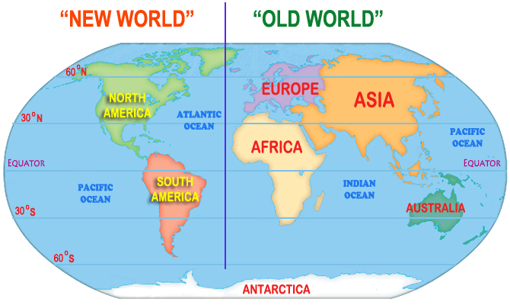
OCEANIA

Slide 6
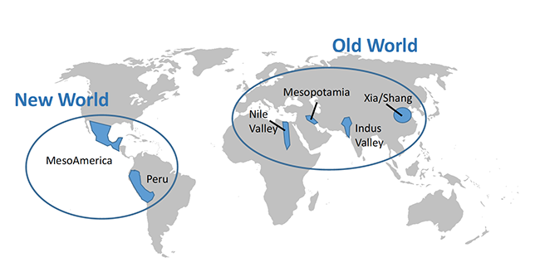

Slide 7
AGENDA – 8/17
Let’s go over the US SPICE chart
Finish Jared Diamond reading (sections 4-6)
Homework:
Thesis statement practice (due MONDAY)
Keep chugging through your reading and notes!

Slide 8
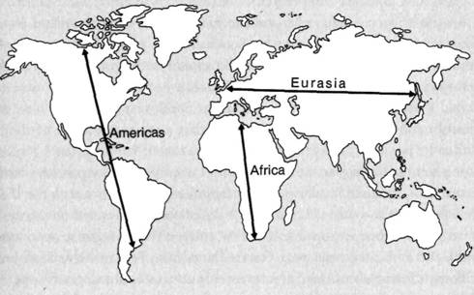
Diamond’s ultimate conclusion:

Slide 9
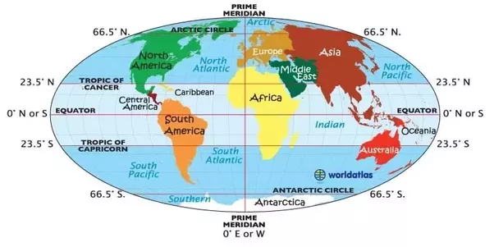

Slide 10
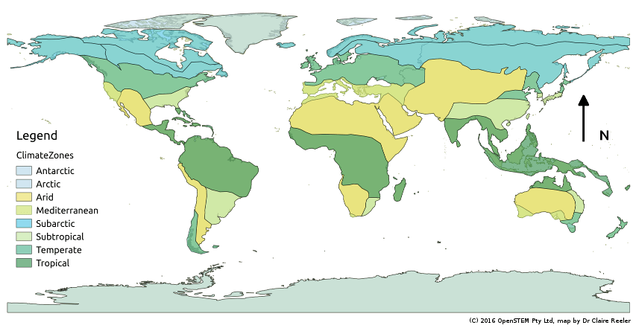

Slide 11
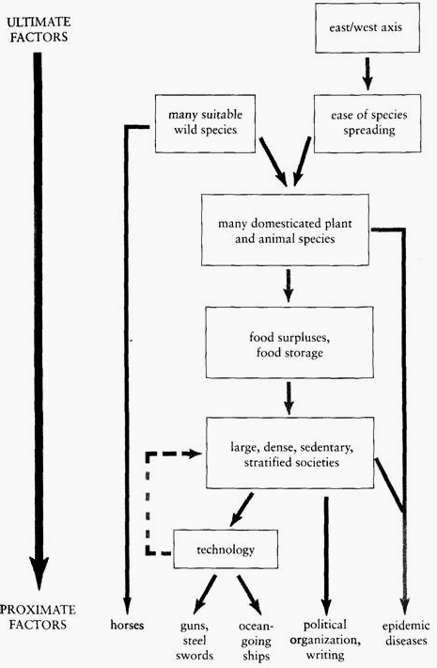
Thesis statement practice:
Which of the five proximate factors do YOU think contributed the most to Eurasia’s dominance of world history?
However you choose to write your thesis statement, it needs to be analytical (tell me why)
Aka, you need to say “because” or “due to”
Due MONDAY

