Slide 1
WORLD BELIEF SYSTEMS
Religions, philosophies, belief systems
(God or gods, and ways of life)

Slide 2
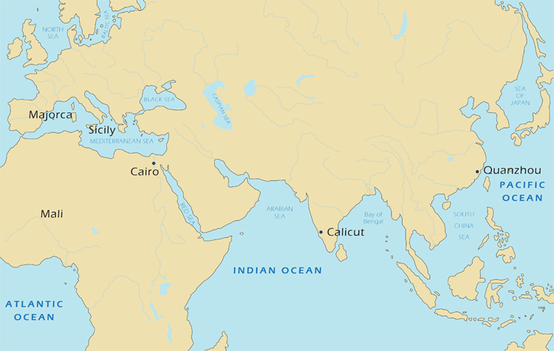
ORIGINS OF BELIEF SYSTEMS
South Asia (India and Nepal):
Hinduism and Buddhism
East Asia (China):
Legalism,
Confucianism,
Daoism

Slide 3
Short answer questions
Identify and explain one similarity between Hinduism and Buddhism.
Identify and explain one difference between Hinduism and Buddhism.

Slide 4
INDIAN BELIEF SYSTEMS
Quick discussion: What do you remember about India/the Indus Valley?

Slide 5
TIMELINE
3300 BCE
1500
1300
500
324
272
158
0
320
550
INDUS VALLEY CIV
REGIONAL KINGDOMS
MAURYAN EMPIRE
REGIONAL KINGDOMS
GUPTA EMPIRE
Aryan invasion; Hinduism
Buddhism established
Return to Hinduism
Ashoka and Buddhism in India

Slide 6
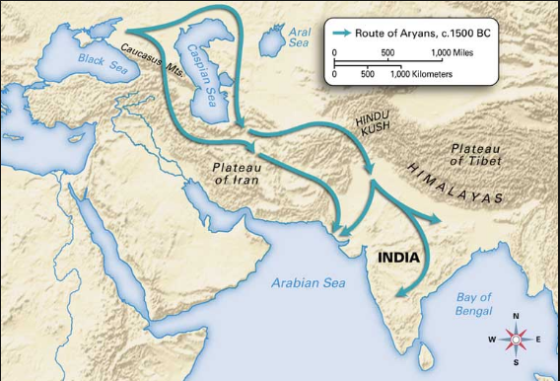
ARYAN migration
1500 BCE, Indo-Europeans settle into India

Slide 7
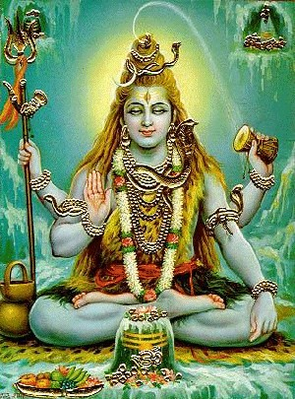
Hinduism
One universal creator – Brahman
Exists in many different forms
Vishnu, Shiva
Sacred Texts
Vedas, Bhagvad Gita, Upanishads
Shiva, the Destroyer

Slide 8
Hinduism
Polytheistic? Monistic?
Shiva, the Destroyer

Slide 9
Hinduism
All part of one being – atman, the inner soul
Nothing is ever completely destroyed until Shiva destroys humanity
→ reincarnation
Vegetarians (mostly)
Shiva, the Destroyer

Slide 10
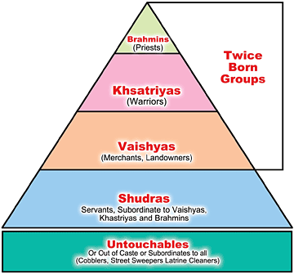
ORGANIZATION OF SOCIETY
Caste system – social organization based on heredity
And, originally, color of skin
You are born into your caste

Slide 11
HINDUISM – MAJOR BELIEFS
KARMA: if you do good things, good things will happen to you; if you do bad things, bad things will happen to you

Slide 12
HINDUISM – MAJOR BELIEFS
DHARMA: fulfilling your castely duty
If you’re a Brahmin, you’re a priest

Slide 13
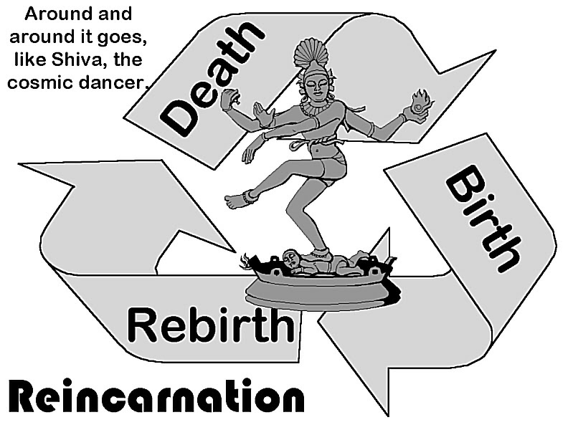
HINDUISM – MAJOR BELIEFS
SAMSARA:
Circle of birth, life, death, and rebirth

Slide 14
HINDUISM – MAJOR BELIEFS
MOKSHA:
Release from samsara (the circle of birth, life, death, and rebirth)
United with the divine

Slide 15
Hinduism
Personal worship of specific gods –
No collective worship as a congregation of people
Rat Temple!

Slide 16
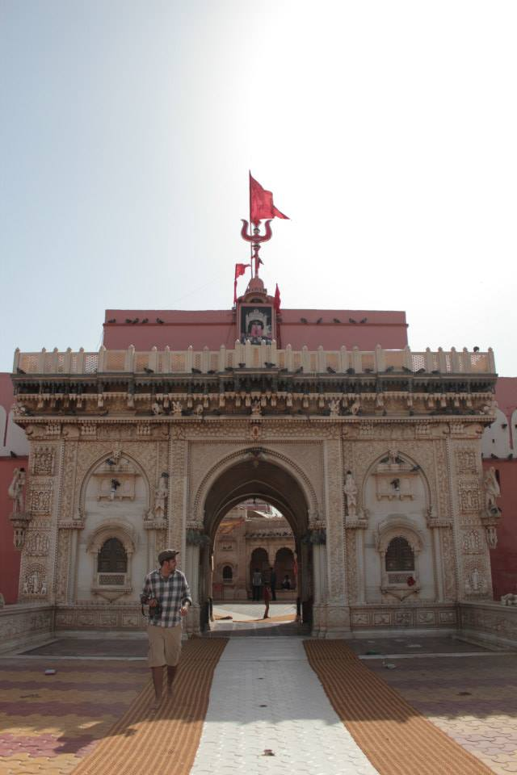
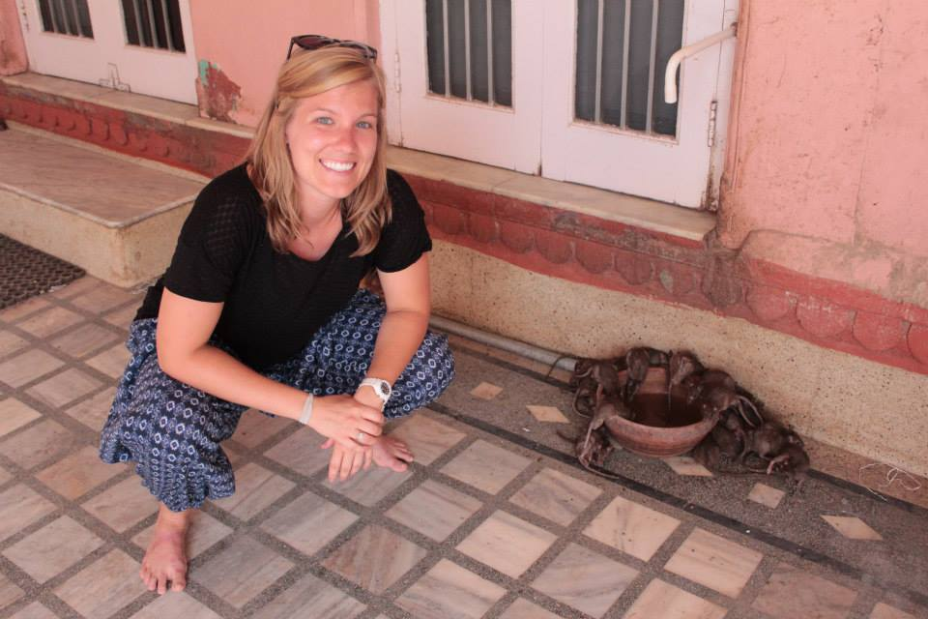

Slide 17
HINDUISM – SOCIAL IMPACTS
Predict:
What are the social impacts of Hinduism?

Slide 18
HINDUISM – SOCIAL IMPACTS
Predict:
Who will like Hinduism?
Who won’t?

Slide 19
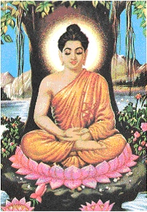
ENTER: SIDDHARTHA GAUTAMA
Born into a Brahmin family
Seeks to find a solution to suffering → reaches enlightenment
Notes:
Super wealthy
Wanted to find more in life, escaped his palace

Slide 20
BUDDHIST TEACHINGS
The Four Noble Truths
All life is suffering
Suffering is caused by desire
To stop suffering, stop desiring
You stop desiring by following the Eightfold Path
right view, right intention, right speech, right action, right livelihood, right effort, right mindfulness, right concentration.

Slide 21
Teachings of the Buddha
Influenced by Hinduism:
Karma
Samsara
State of release from samsara
Called “nirvana”

Slide 22
Unique to Buddhism
Denies relevance of gods
Some forms of Buddhism acknowledge a deity
Denies caste system
Promotes equality

Slide 23
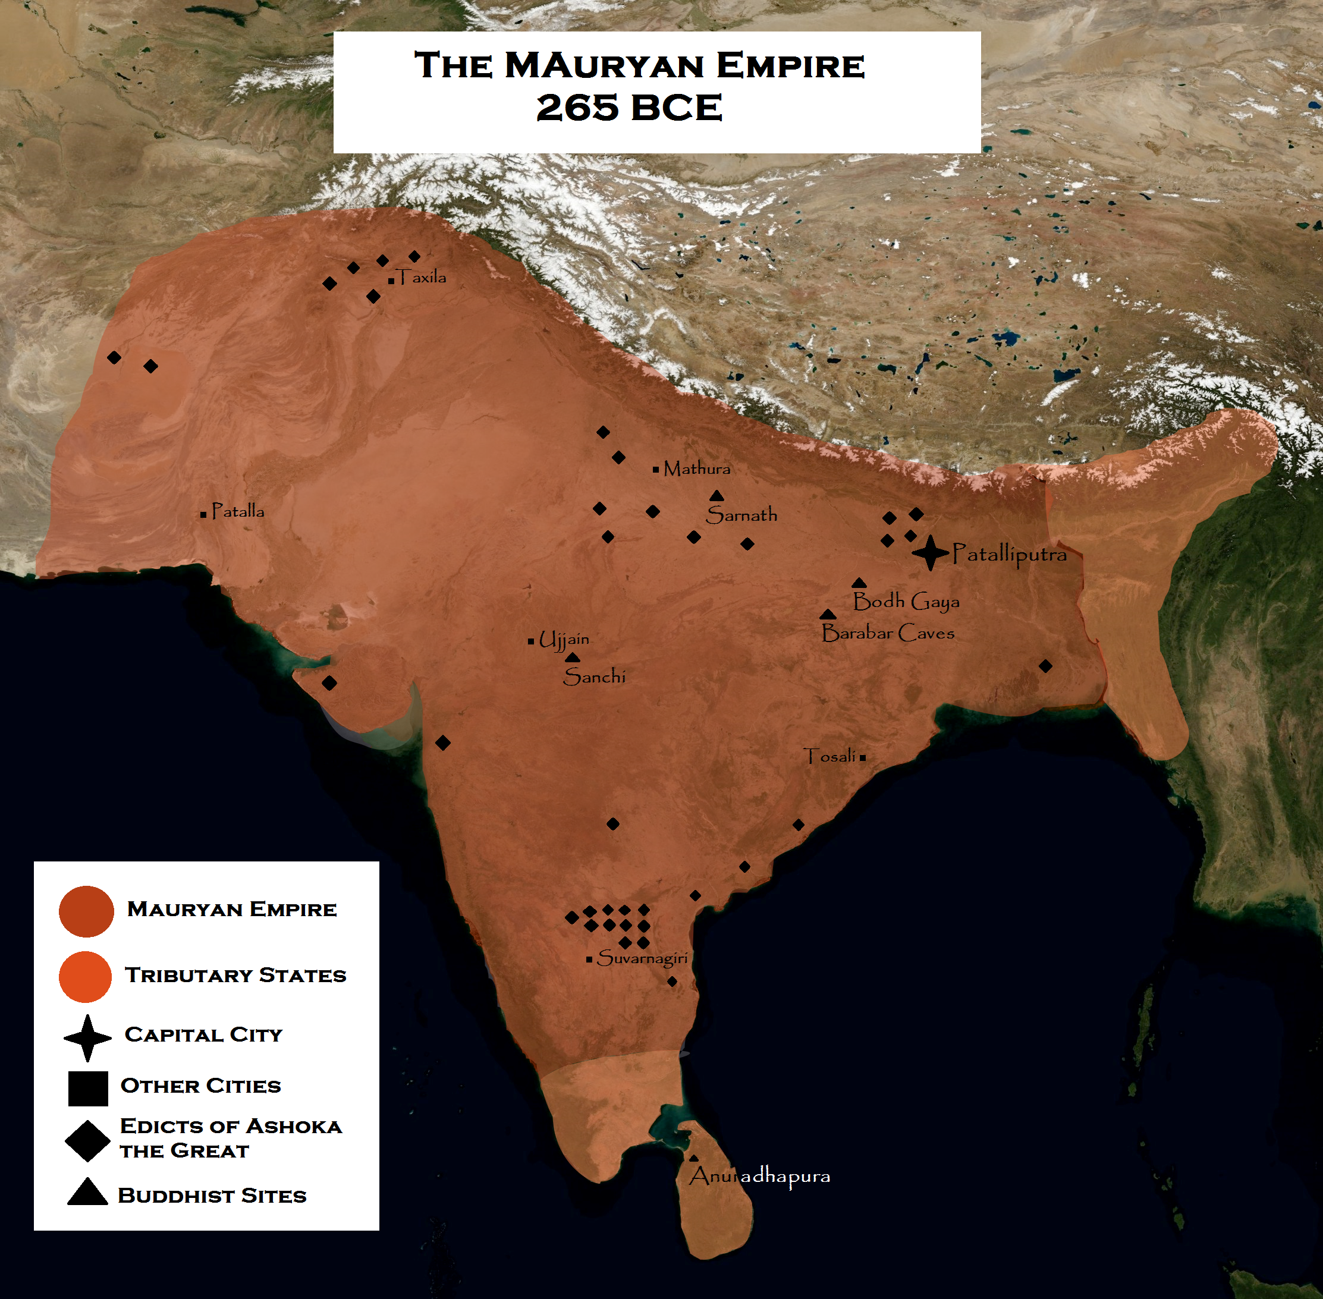
SOCIAL AND POLITICAL EFFECTS
Indian Emperor Asoka (268-232 BCE) converts to Buddhism as a result of a his conquering of India
Puts power of the throne into spreading Buddhism
Spreads it throughout India and Asia
No deity – can be practiced alongside other belief systems

Slide 24
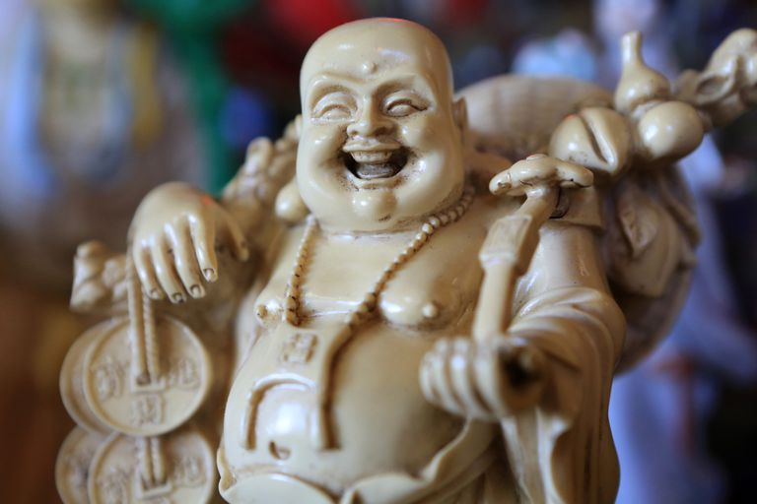
SOCIAL EFFECTS
Buddhists live life free of material possessions
Then – what’s the deal with the fat happy Buddha?

Slide 25
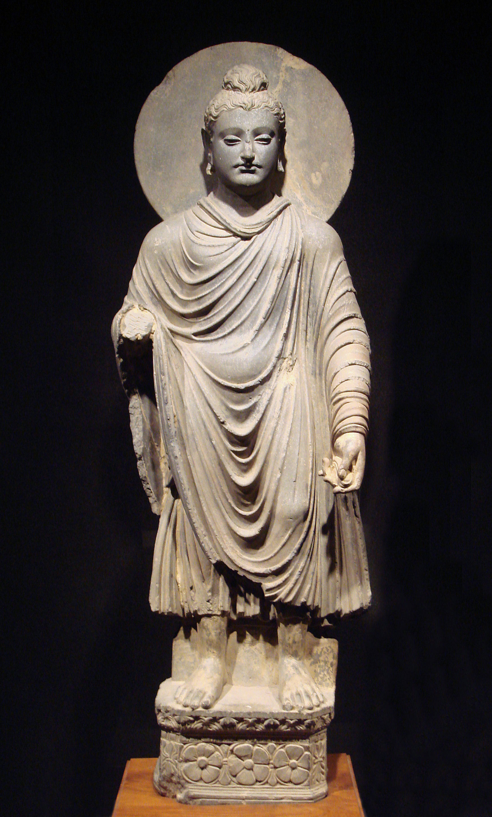
SOCIAL EFFECTS
SYNCRETISM!! As religions spread, they adopt customs of local cultures.

Slide 26
Spread of Buddhism & Asoka

Slide 27
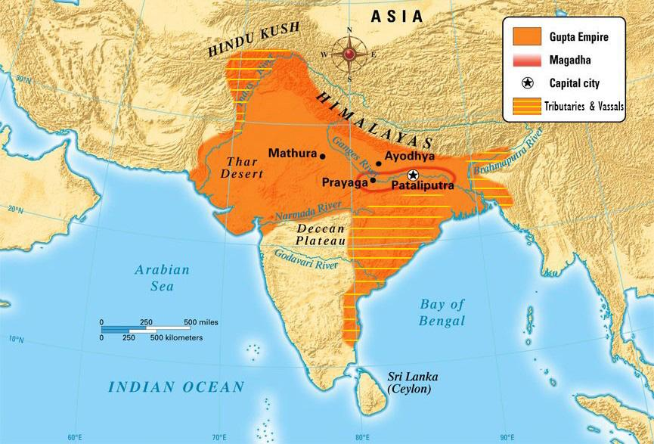
SOCIAL AND POLITICAL EFFECTS
During the Gupta Empire (after Maurya), India converts back to Hinduism
Why?

Slide 28
South Asia (India and Nepal):
Hinduism and Buddhism
South Asia (India and Nepal):
Hinduism and Buddhism
East Asia (China):
Legalism,
Confucianism,
Daoism

